Slide 1

Lanemark Combustion Engineering Limited
Lanemark House
Whitacre Road
Nuneaton
CV11 6BW
U.K

Slide 2
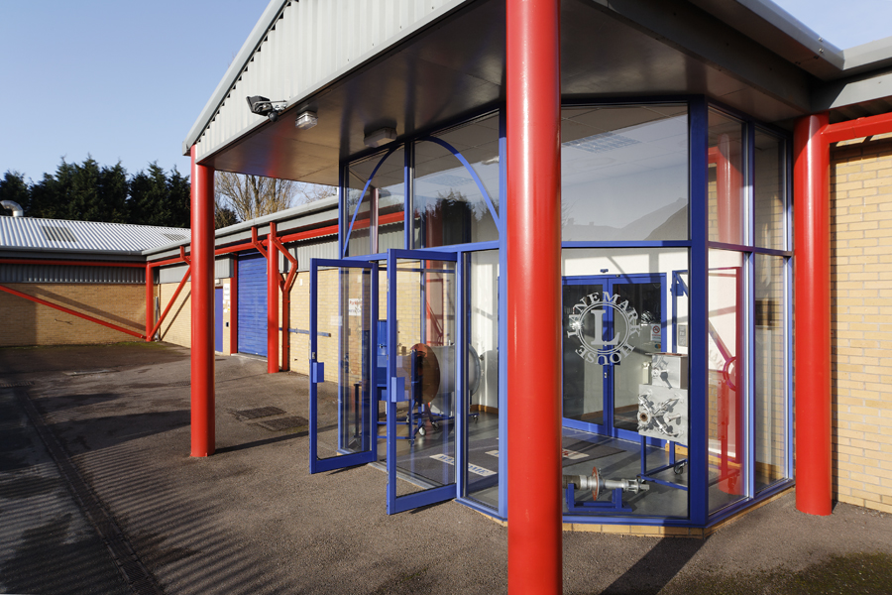
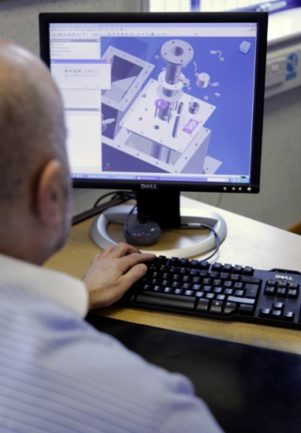
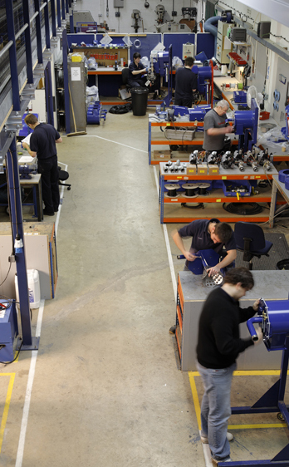
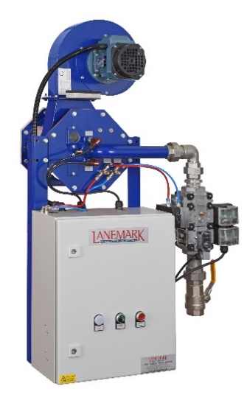
Lanemark Combustion Engineering Limited
UK Company started operations
in 1981 following a Management Buy-Out from Dunlop Limited.
Location – Nuneaton, Warwickshire, UK
15 miles (25 km) east of Birmingham
90 miles (150 km) north of London.
Modern 1000 m² factory built to Lanemark specifications in 1996.
Second Management Buy-Out :
December 2005
ISO 9001 : 2008 QUALITY SYSTEM

Slide 3

Global Reach
Australia
Austria
Belgium
Canada
China
Czech Republic
Germany
Holland
Hungary
India
Indonesia
Italy
Luxembourg
Malaysia
Mexico
New Zealand
Norway
Poland
Russia
Singapore
Slovakia
Sweden
Thailand
Turkey
United Kingdom
USA
OUR
DISTRIBUTORS

Slide 4
Product Summary
Lanemark Product Ranges
TX/TRX/MTX Tank Heating Burner Systems
FD Process Air Heating Gas Burner Systems
Midco HMA2A/DB Replacement Air Heating Systems
Petrochemical Industries Burner Systems
BurnerCare – Spares & Service Support
  Applications
  Product description
  Typical installation examples

Slide 5
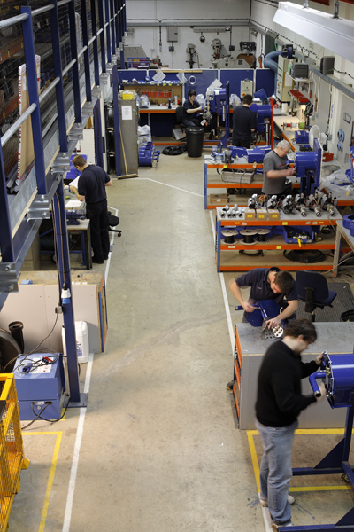
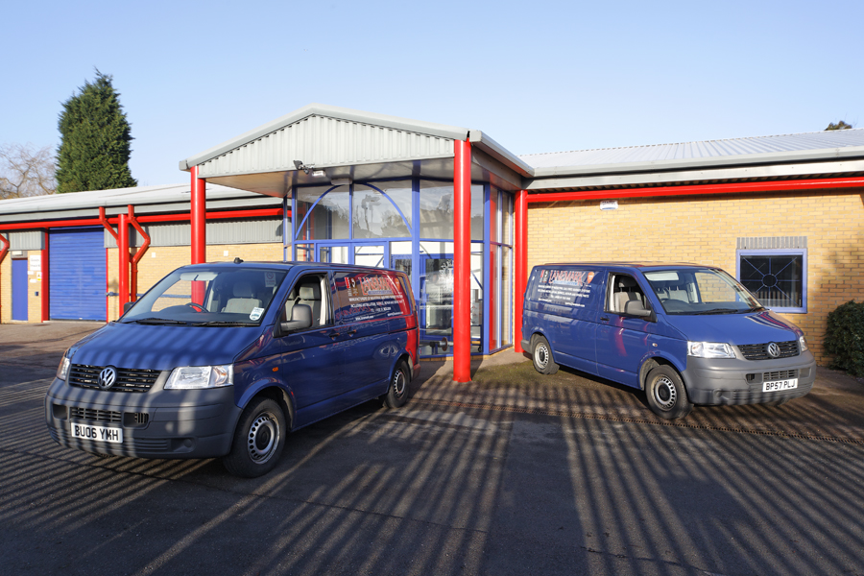
Lanemark House

Slide 6
Lanemark Process Tank and Air Heating
Gas Burner Systems
Lanemark Combustion Engineering Limited
Lanemark House
Whitacre Road
Nuneaton
CV11 6BW
U.K

Slide 7

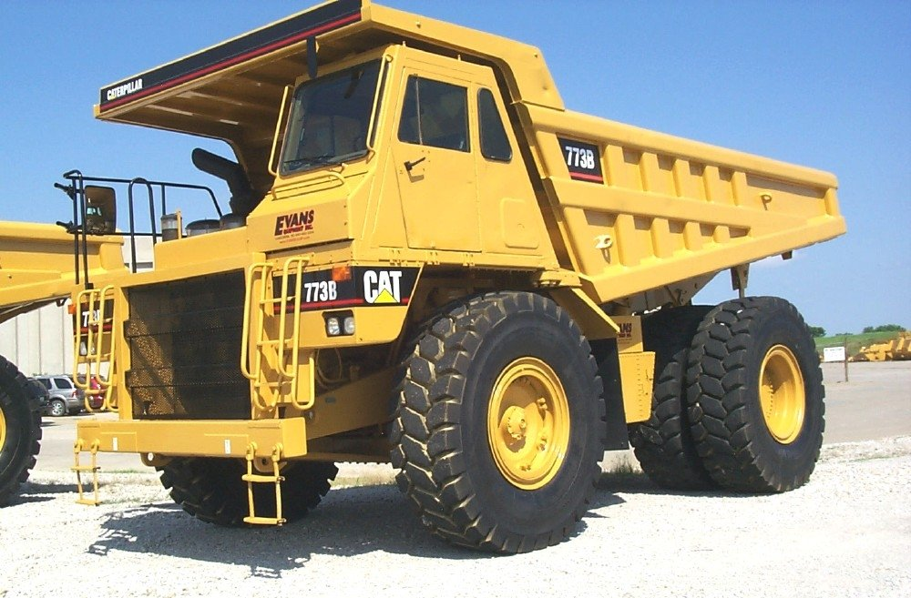
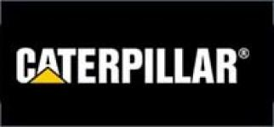
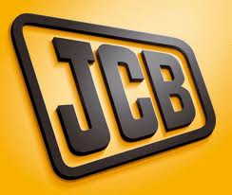
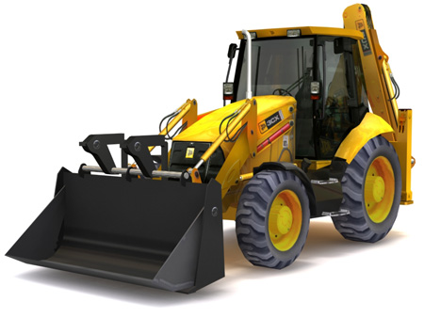
Lanemark Process Heating Burner Systems

Slide 8
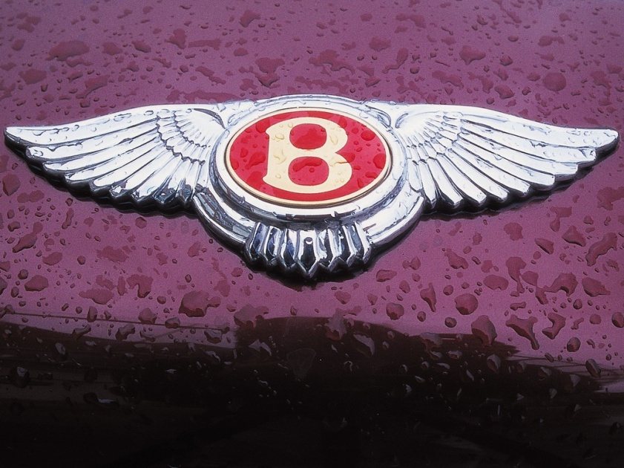
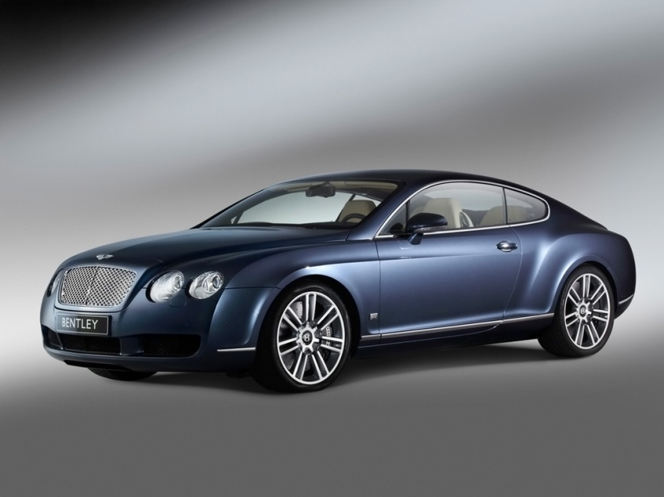
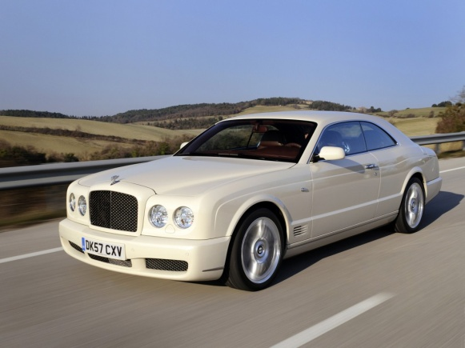
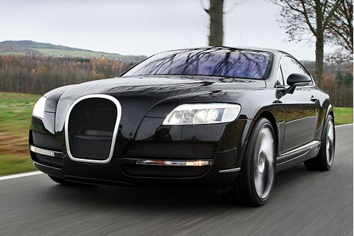
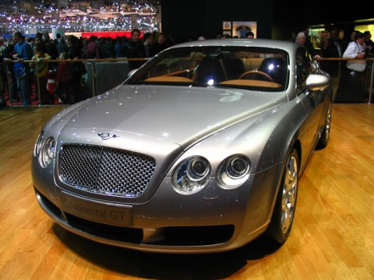
Lanemark Process Heating Burner Systems

Slide 9
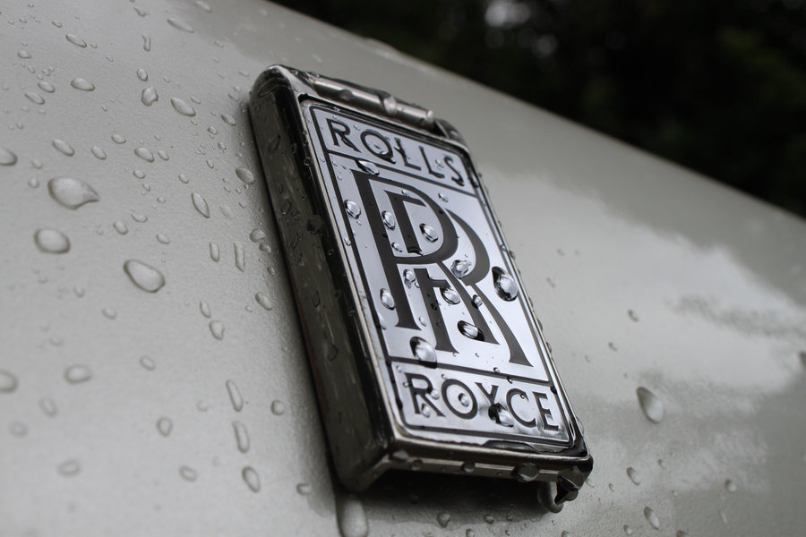
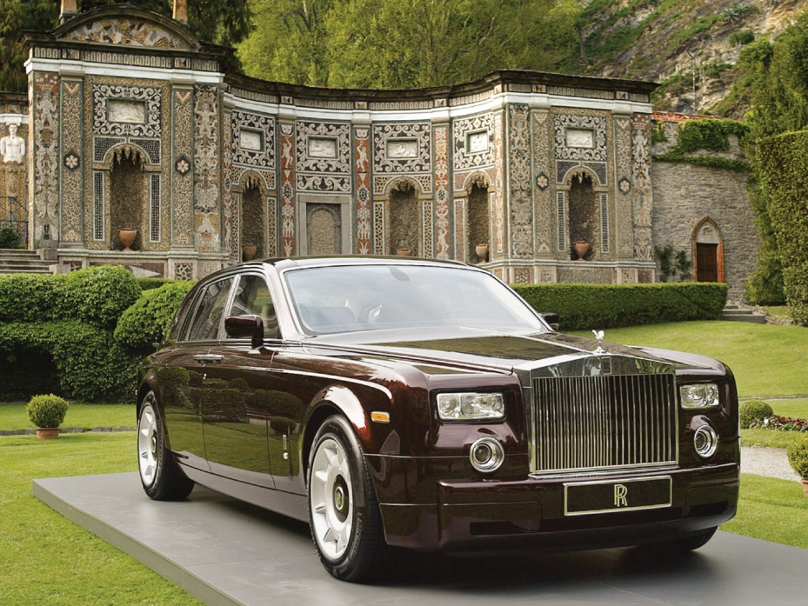
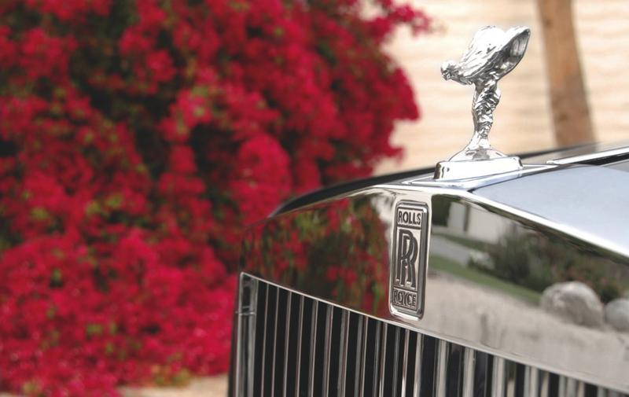
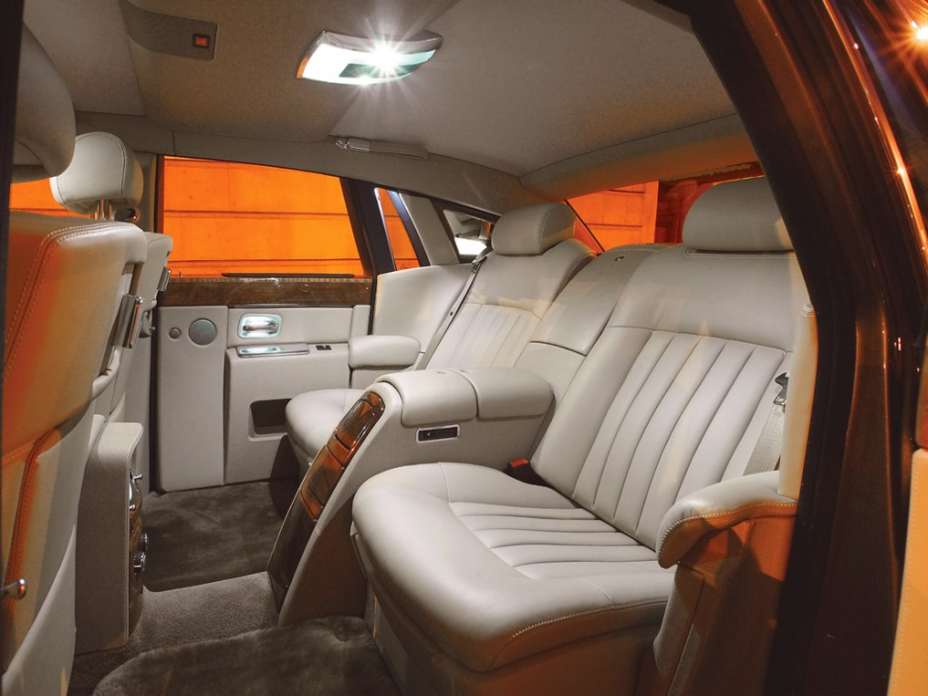
Lanemark Process Heating Burner Systems

Slide 10

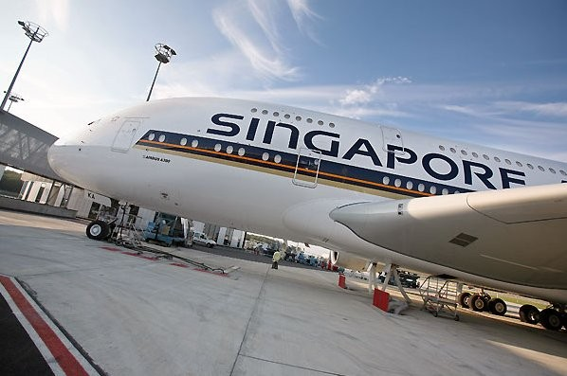
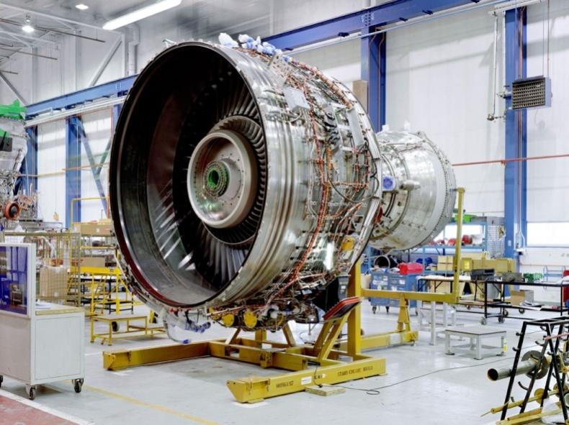
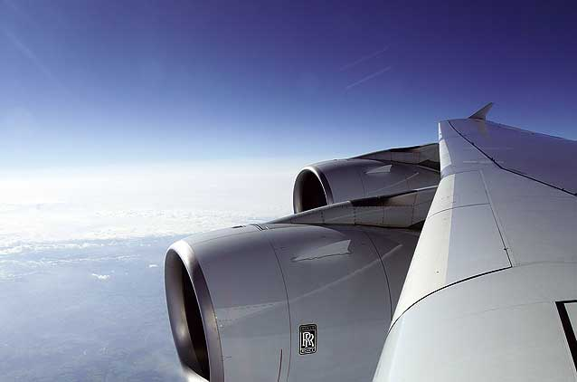
Lanemark Process Heating Burner Systems

Slide 11

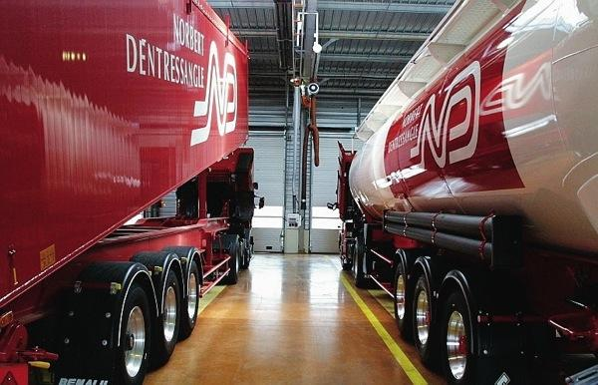

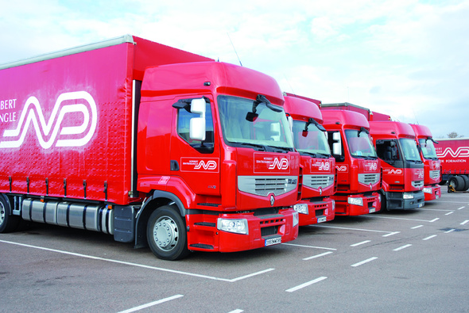
Lanemark Process Heating Burner Systems

Slide 12
Lanemark Process Tank Heating
Gas Burner Systems
Lanemark Combustion Engineering Limited
Lanemark House
Whitacre Road
Nuneaton
CV11 6BW
U.K

Slide 13
Lanemark Tank Heating Burner Systems
Lanemark small diameter gas fired immersion heaters are used to heat process liquids in many types of industry.
They offer considerable energy savings to end-users by:
replacing existing inefficient heating methods such as steam or hot water - savings of 40-50% are easily achieved.
providing close temperature control and a fast response to changes in heat demand.
offering a totally flexible approach to process heating – individual tanks or groups of tanks can be heated when required.

Slide 14
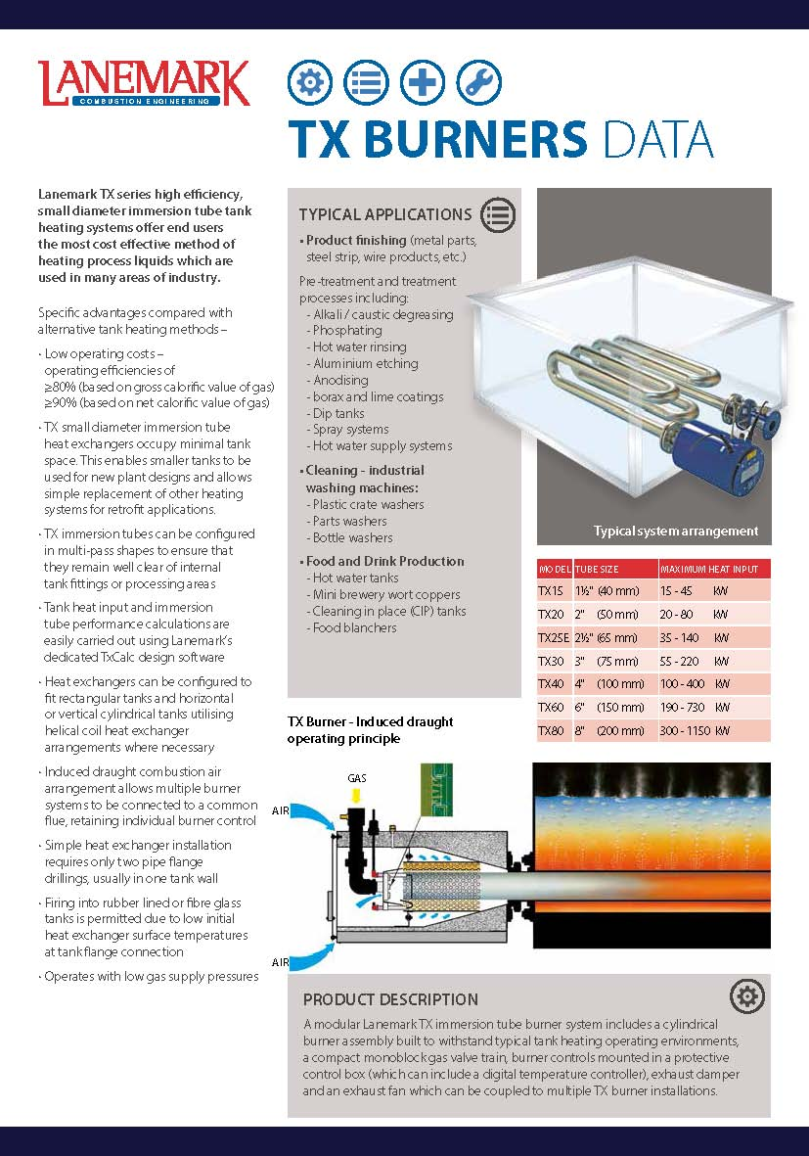
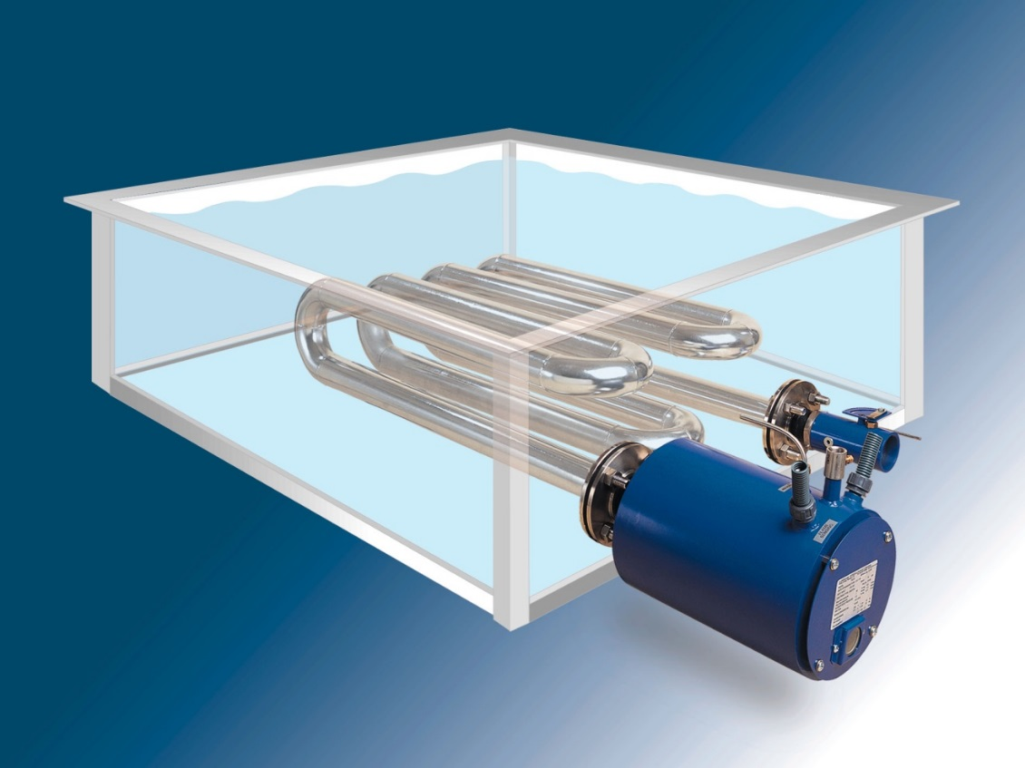
Lanemark Tank Heating Burner Systems
TX Series: 7 Models: 45 kW to 1150 kW
TX15 (1½”) – TX80 (8”)

Slide 15
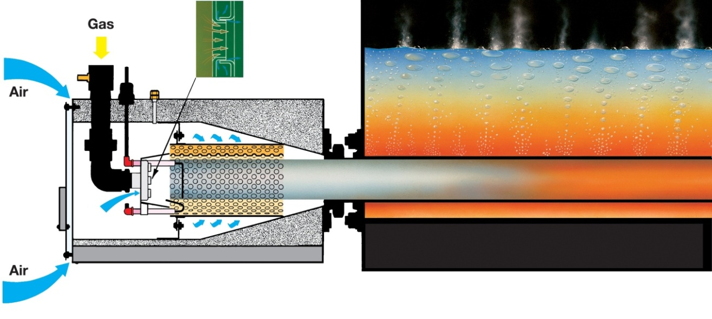
Lanemark Tank Heating Burner Systems
TX Burner - Operating Principle
100%
90%
80%

Slide 16
Lanemark Tank Heating Burner Systems
Product Description
Lanemark tank heating system components:
    1. Gas burner
    2. Gas valve assembly
    3. Burner Controls
    4. Temperature controls
    5. Immersion tube heat exchanger
    6. Exhaust damper
    7. Exhaust fan

Slide 17
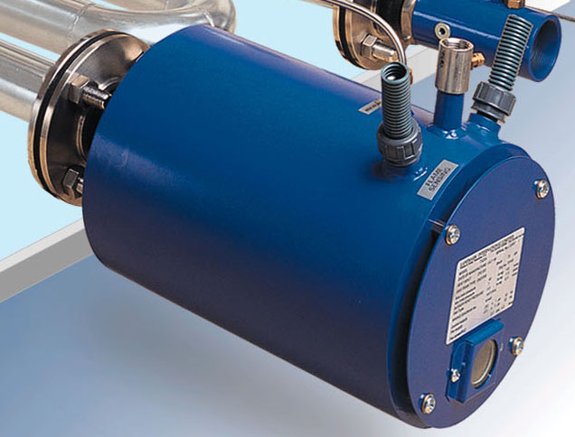
Lanemark Tank Heating Burner Systems
Lanemark tank heating system components:
1. TX Series Gas Burner

Slide 18
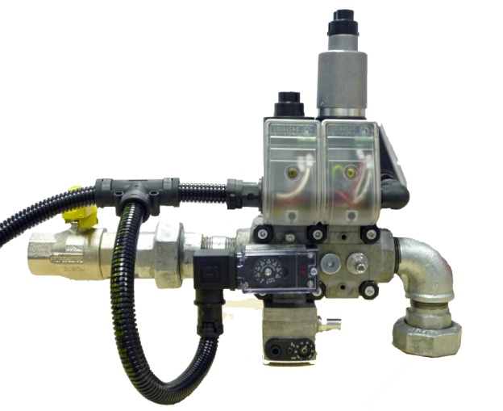
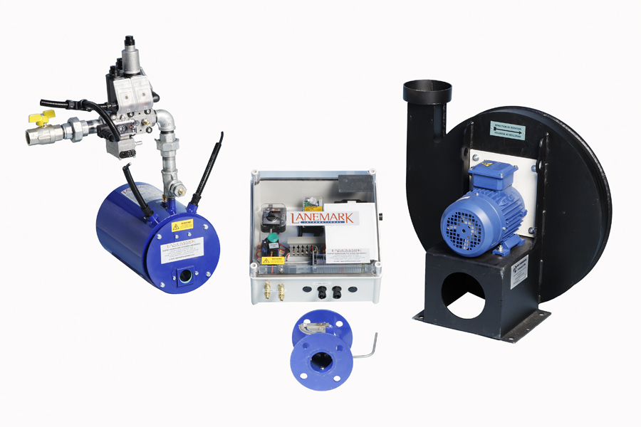
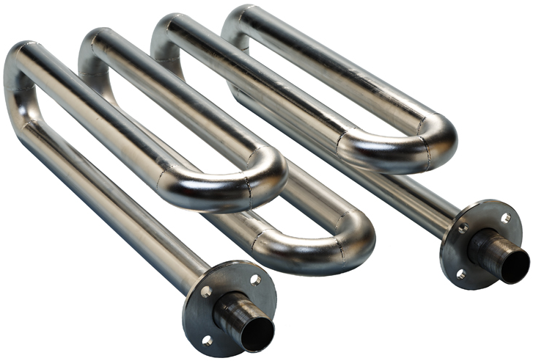
Lanemark TX Tank Heating Burner Systems
The Lanemark TX series burner system also comprises the following key assemblies:
Gas valve train
Burner controls
Immersion tube heat exchanger
Flanged exhaust damper
6. Exhaust fan
2
3
4
6
5
4

Slide 19
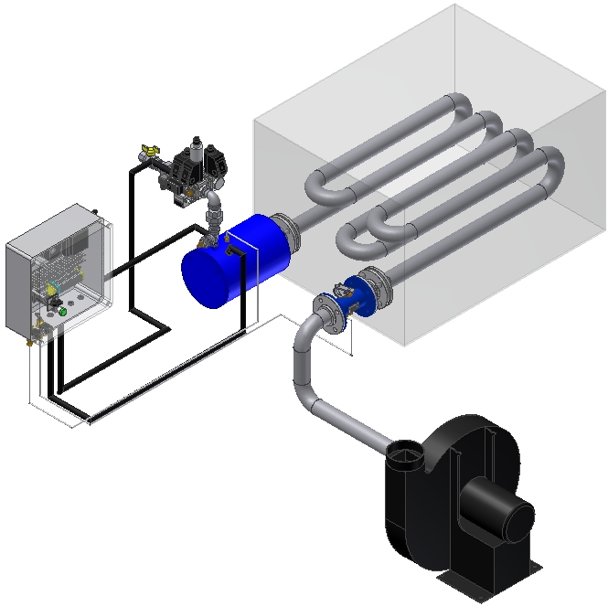
Lanemark Tank Heating Burner Systems
A typical Lanemark TX series high efficiency, small diameter immersion tube tank heating system assembly:

Slide 20

Lanemark Tank Heating Burner Systems
TxCalc Tank Heat Loss and Heat Exchanger Design software:
TxCalc calculates tank heat losses and heat input requirements
TxCalc predicts the performance of alternative small diameter
immersion tube heat exchanger configurations
TxCalc selects the correct exhaust fan for each Lanemark
tank heating burner system (or groups of burner systems)

Slide 21
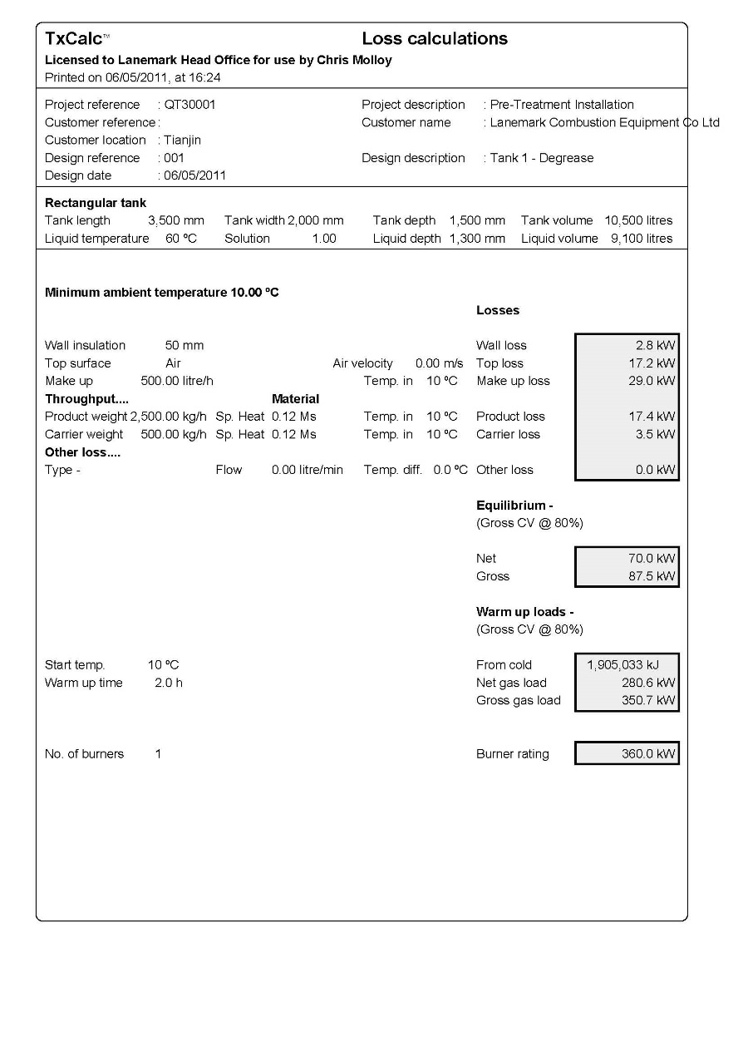
Lanemark Tank Heating Burner Systems
Lanemark TxCalc Heat Loss Computer Program
The TxCalc® “Heat Losses” section of the program provides a comprehensive statement of the heat loads, which will result from:
1. Production Heat Losses (kW)
Wall losses
Surface losses
Make-up losses
Production/carrier losses
Other losses (i.e. spray losses)
2. Warm-up Loads (kW)

Slide 22
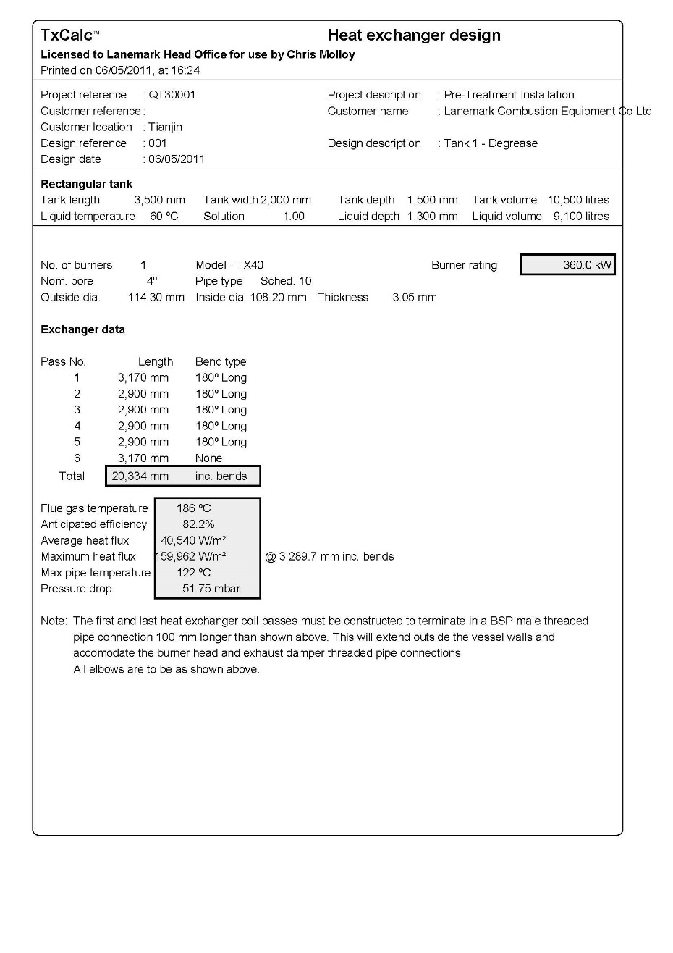
Lanemark Tank Heating Burner Systems
Lanemark TxCalc Heat Exchanger Computer Program
The TxCalc® program “models” the anticipated performance of this suggested design by breaking down the total proposed heat exchanger into a number of zones (each equivalent to “one pipe diameter”) and carrying out heat exchange calculations at every zone.
The following is calculated:
Expected efficiency
Flue gas temperature
Average heat flux
Maximum heat flux
Maximum pipe temperature
Pressure drop

Slide 23
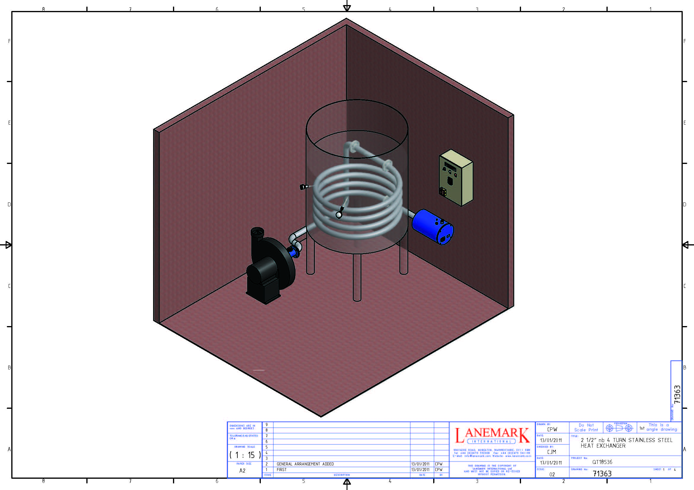
Lanemark Tank Heating Burner Systems
“Helical coil” immersion tube heat exchangers designed for installation in cylindrical vessels.

Slide 24
Lanemark Tank Heating Burner Systems
Applications
A. Product/Metal Finishing
Heating of all types of process tanks containing liquids such as:
        water and de-mineralised water
        alkali degreasing chemicals
        phosphating chemicals (zinc, iron, manganese)
Typical processes include:
        pre-treatment of metal parts prior to painting
        aluminium anodising
        plating

Slide 25
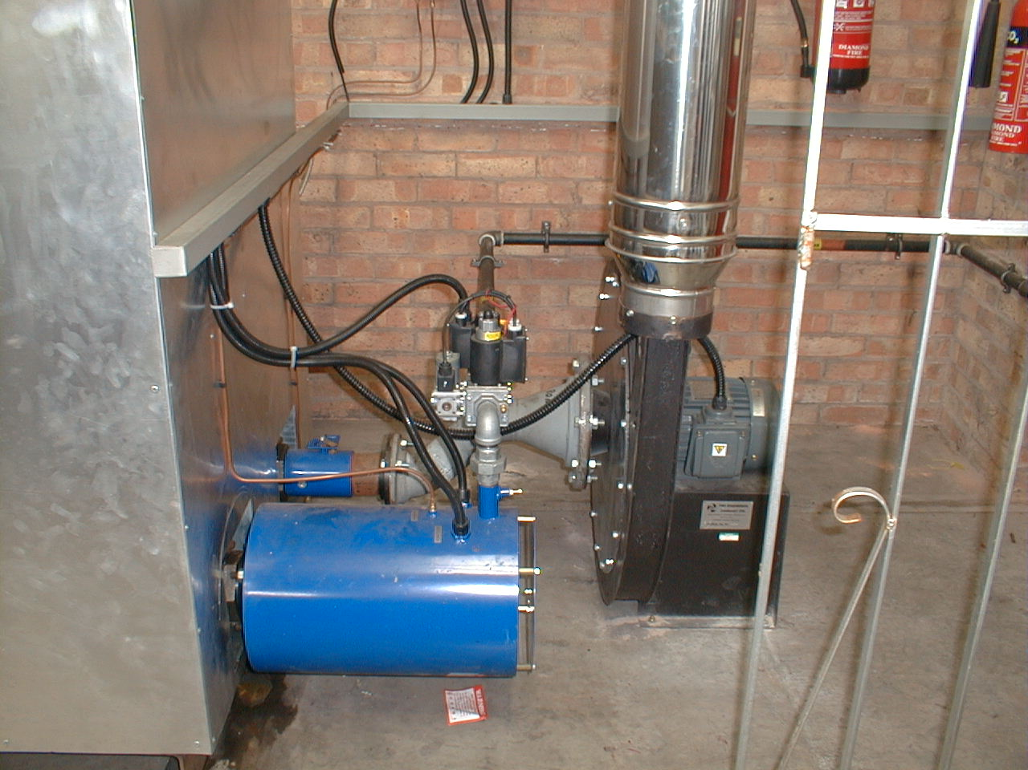
Lanemark Tank Heating Burner Systems
Site Installation: Offshore Stainless Ltd, UK
TX 30N – 210 kW

Slide 26
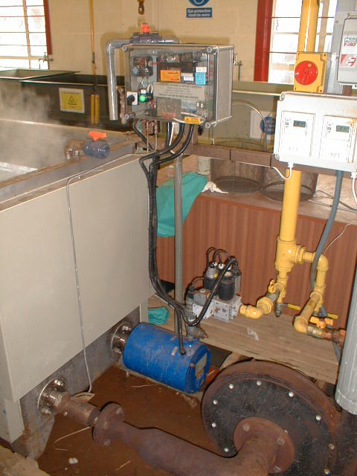
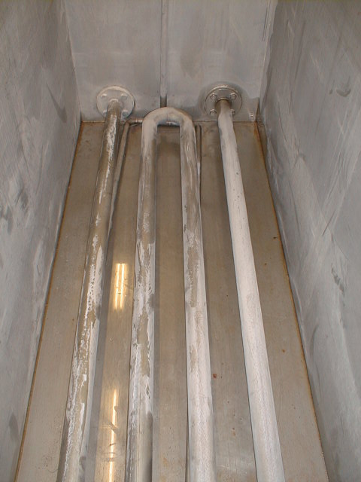
Lanemark Tank Heating Burner Systems
Site Installation: IPE, UK
TX 20 – 60 kW Stainless steel immersion tube heat exchanger
(zinc phosphate)

Slide 27
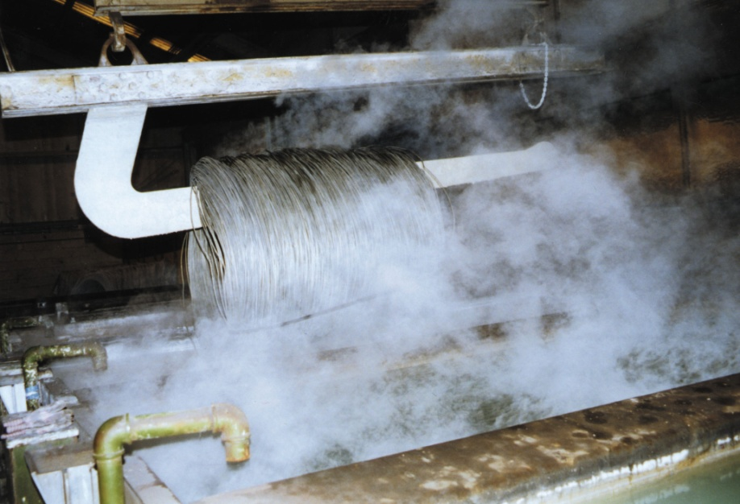
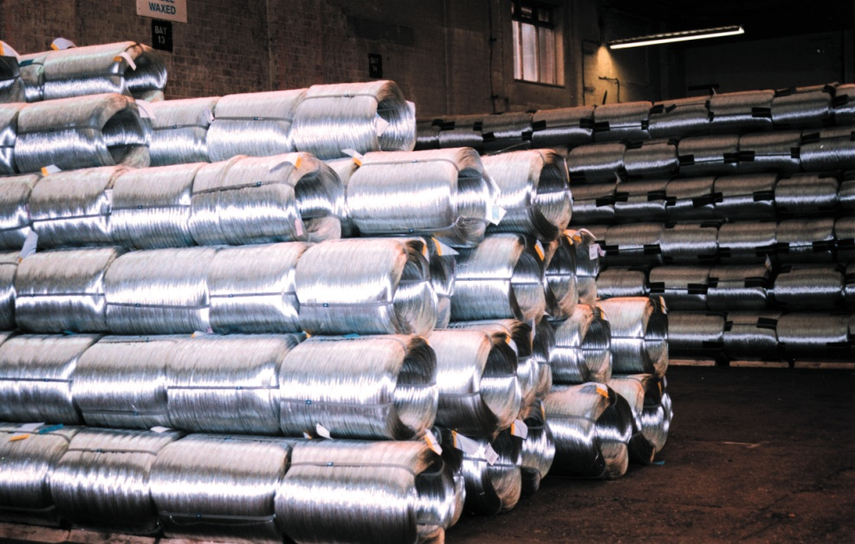
Lanemark Tank Heating Burner Systems
Application: Wire Processing
Degreasing, coating, phosphating
Finished product

Slide 28
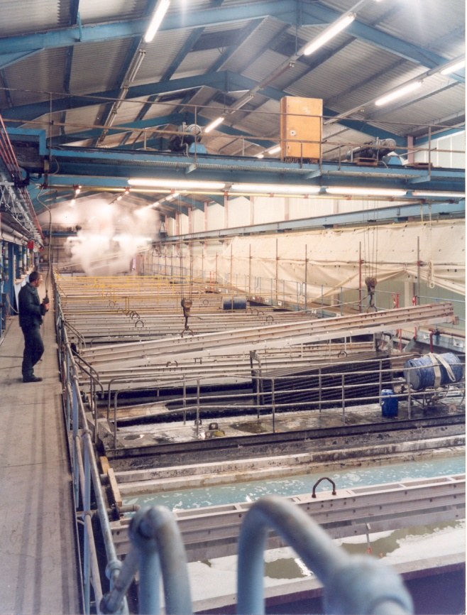
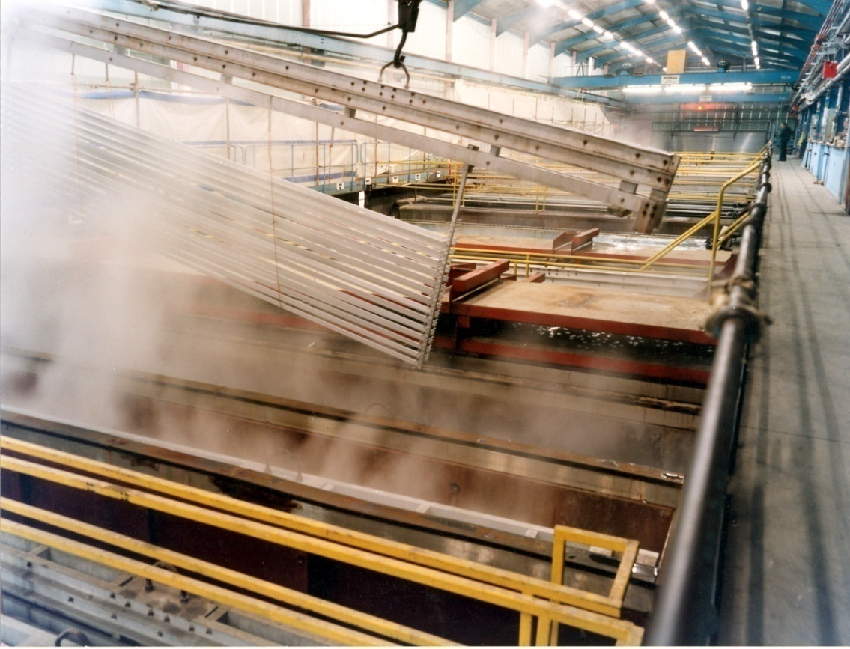
Lanemark Tank Heating Burner Systems
Application: Aluminium Anodising
Typical Aluminium Anodising Plant

Slide 29
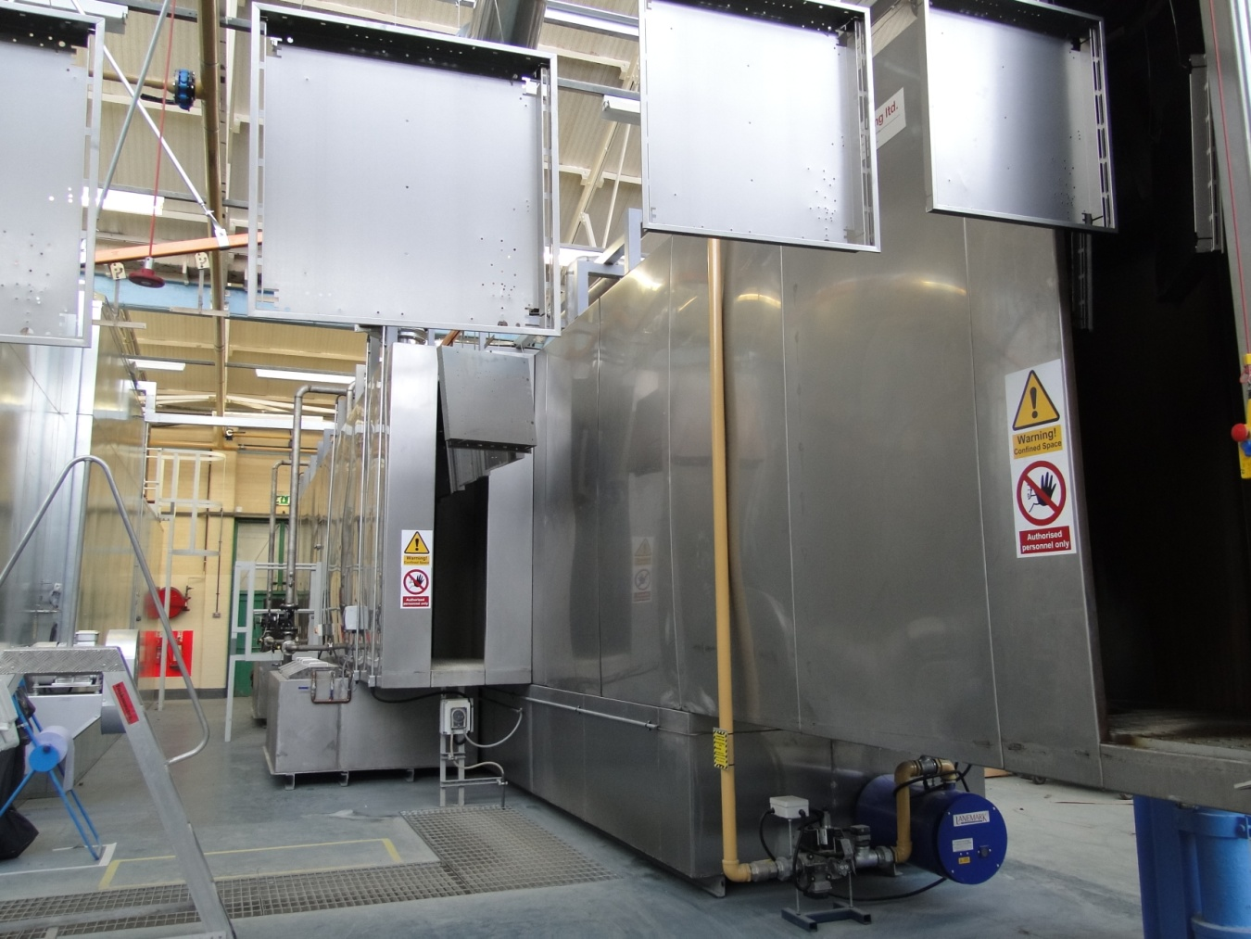
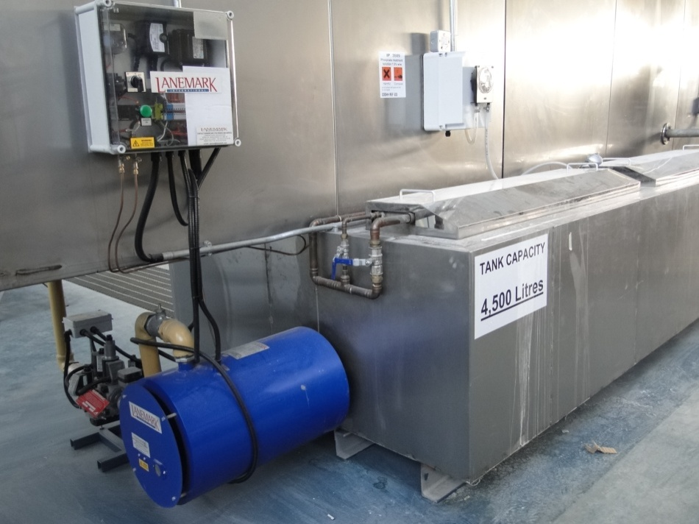
Lanemark Tank Heating Burner Systems
Application: Paint Pre-Treatment - Spray
Lanemark OEM: TD Finishing, UK
Site Installation: Coopers Lighting Limited, UK
2 x TX60 Tank Heating Systems

Slide 30
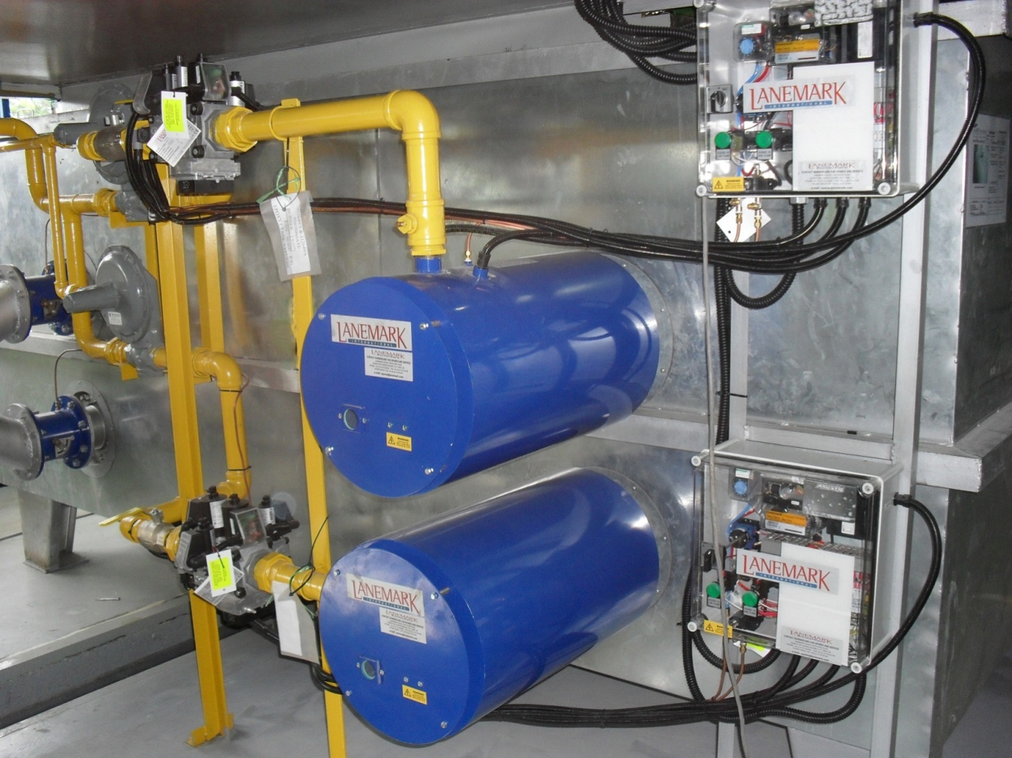
Lanemark Tank Heating Burner Systems
Application: Paint Pre-Treatment - Spray
Site Installation: Panweld, Malaysia/ Samsung Microwave Oven Manufacturing

Slide 31
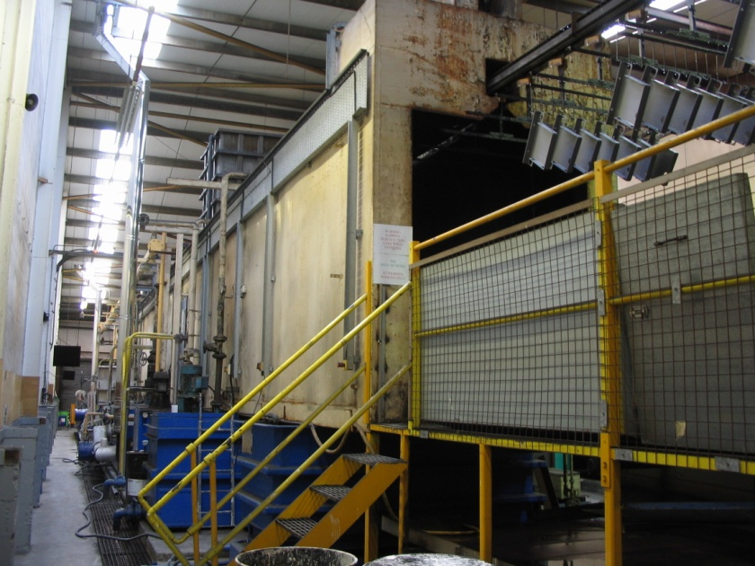
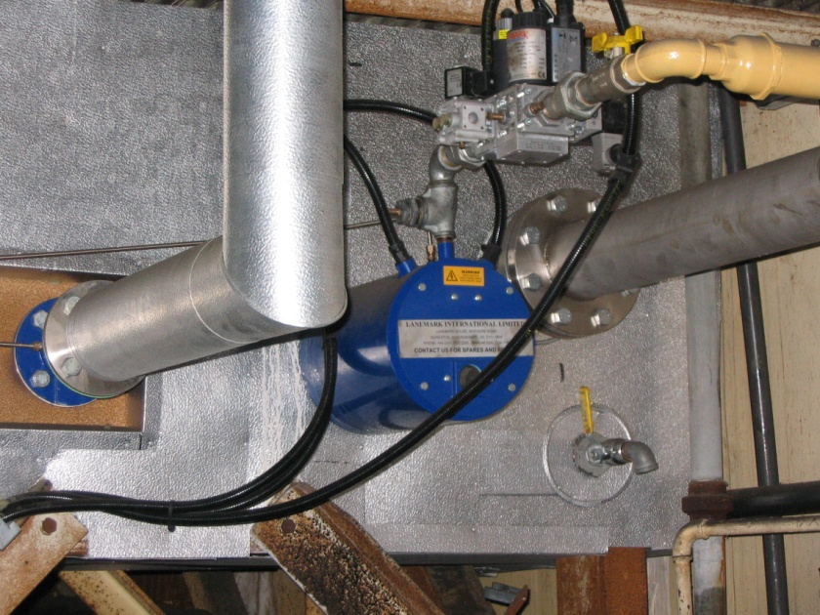
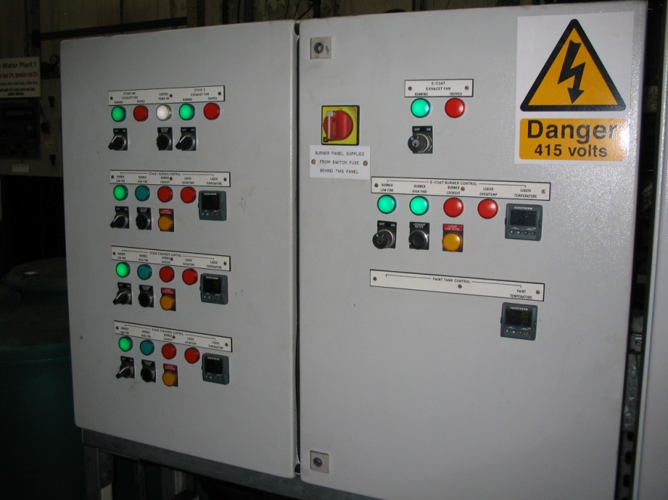
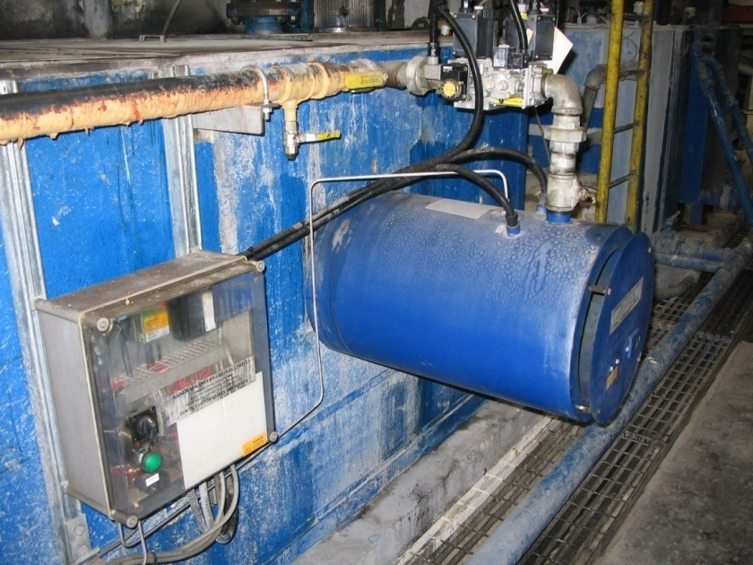
Lanemark Tank Heating Burner Systems
Application: Paint Pre-Treatment - Spray
Site Installation: Metokote, UK

Slide 32
Lanemark Tank Heating Burner Systems
Applications
B. Washing Machines
Heating of all types of industrial and commercial washing machines containing liquids such as:
        alkali degreasing/detergent chemicals
        rinse water
typical processes include:
        pre-wash, washing and hot rinsing of plastic crates, and metal trays for the food and drink industries

Slide 33
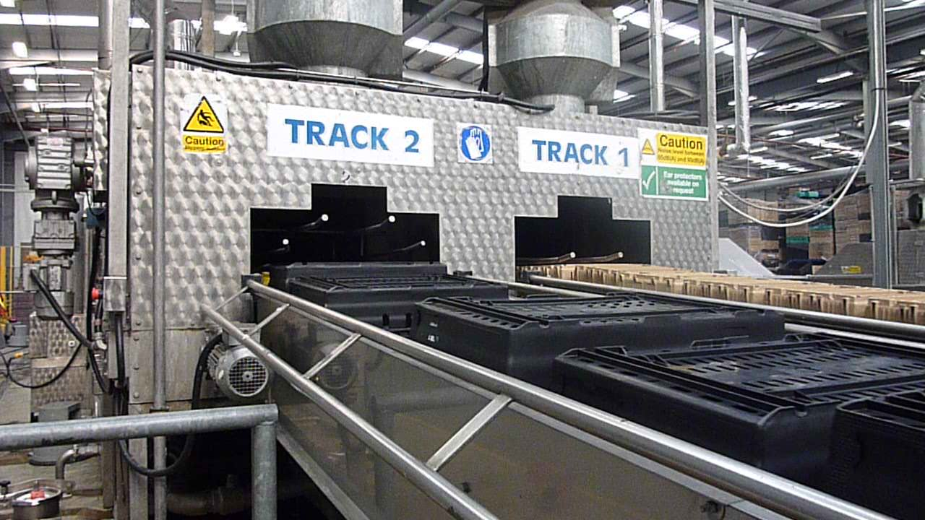
Lanemark Tank Heating Burner Systems
Application: Twin Track Plastic Tray Washing Machine

Slide 34


Lanemark Tank Heating Burner Systems
Application: Plastic Crate Washing Machines
TX 40 Tank Heating/Midco DB01 Dryer
TX 30 Tank Heater + Protective Inlet Cover

Slide 35
Lanemark Tank Heating Burner Systems
Applications
C. Food Processing including meat and poultry scalding
Heating of water tanks for the scalding of chickens, turkeys, pigs and other animals prior to the removal of feathers or hairs.
Please note however that particular care must to make sure that Lanemark gas burner equipment is fully protected from the cleaning processes used at the end of a processing period (for example: water hoses)

Slide 36


Lanemark Tank Heating Burner Systems
Application: Food Processing Tanks
TX40N - Stainless steel immersion tubes

Slide 37
Lanemark Tank Heating Burner Systems
Applications
D. Other applications include the heating of other liquids such as:
        beers
        alkali detergents
        oils
Other processes include:
        beer “wort” and hot water tanks in micro/mini breweries
        cooking processes for food products such as vegetable “blanching”, frying ……
        “cleaning in place” (CIP) systems for milk dairies

Slide 38

Lanemark Tank Heating Burner Systems
Application: Dairy Cleaning In Place (CIP) Tanks
TX40N - Stainless steel burners, gas pipe-work fittings, control boxes and exhaust dampers

Slide 39



Lanemark Tank Heating Burner Systems
Site Installation: Purity Brewery, UK
TX 30 – 190 kW operating into a 3” (75 mm) helical coil
(Beer Brewing Vessel)

Slide 40

Lanemark TX tank heating
burners are made under licence
in the USA by Power Flame Inc.
Power Flame Models:
CX15 – CX60
50,000 – 2,500,000 Btu/h

Slide 41

Power Flame Inc. – USA
Power Flame Models:
CX15 – CX60
50,000 – 2,500,000 Btu/h

Slide 42
Lanemark Process Air Heating
Gas Burner Systems
Lanemark Combustion Engineering Limited
Lanemark House
Whitacre Road
Nuneaton
CV11 6BW
U.K

Slide 43


Lanemark Process Air Heating Burner Systems
FDE Series Oven and Dryer Burners
5 Models : FD5E – FD15EN/P
Heat output range : 9 kW – 660 kW
  43
Notes:
43

Slide 44

Lanemark Process Air Heating Burner Systems
FDE series burner systems:
Operation : High/Low or On/Off
(Modulating gas only option also available)
The FDE burner comprises a burner , combustion air fan, compact monoblock valve train and burner controls mounted on a control plate.
Model | Gas Valve Train | Heat Input Range
FD5E | G96 (¾”) /VCD1 (1”) | 9 - 220kW (30,000 - 750,000 Btu/h)
FD10E | VCD1 (1”)/VCD2 (1½”) | 13 - 440kW (45,000 - 1,500,000 Btu/h)
FD15E | VCD2 (1½”) | 18 - 660kW (60,000 - 2,250,000 Btu/h)
Notes:
44

Slide 45


Lanemark Process Air Heating Burner Systems
FDC Series Oven and Dryer Burners
9 Models : FD5C – FD35CN/P
Heat output range : 9 kW – 1550 kW

Slide 46

Lanemark Process Air Heating Burner Systems
FDC series burner systems:
Operation : High/Low or On/Off
(Modulating gas only option also available)
The FDC burner comprises a burner including protective burner cowl, combustion air fan, compact monoblock valve train and burner control box.
Model | Gas Valve Train | Heat Input Range
FD5C | G96 (¾”) /VCD1 (1”) | 9 - 220kW (30,000 - 750,000 Btu/h)
FD10C | VCD1 (1”)/VCD2 (1½”) | 13 - 440kW (45,000 - 1,500,000 Btu/h)
FD15C | VCD2 (1½”) | 18 - 660kW (60,000 - 2,250,000 Btu/h)
FD20/25C | VCD2 (1½”)/VCD3 (2”) | 25 - 1000kW (85,000 – 3,400,000 Btu/h)
FD30/35C | VCD3 (2”) | 45 - 1550kW (155,000 - 5,300,000 Btu/h)
Notes:
46

Slide 47


Lanemark Process Air Heating Burner Systems
FDGA Series Oven and Dryer Burners
8 Models : FD 5GA-35GAN/P
Heat output range : 9 kW – 1550 kW
  47
Notes:
47

Slide 48

Lanemark Process Air Heating Burner Systems
FDGA series burner systems:
Operation : Modulating Gas + Air
(Utilising variable speed combustion air fan control)
The FDGA burner comprises a burner including protective burner cowl, combustion air fan, compact monoblock gas/air ratio valve train and burner controls mounted within a control box.
Model | Gas Valve Train | Heat Input Range
FD5GA | VCV1 (1”) | 9 - 220kW (30,000 - 750,000 Btu/h)
FD10GA | VCV1 (1”)/VCV2 (1½”) | 13 - 440kW (45,000 - 1,500,000 Btu/h)
FD15GA | VCV2 (1½”) | 18 - 660kW (45,000 - 2,250,000 Btu/h)
FD20/25GA | VCV2 (1½”)/VCV3 (2”) | 25 - 1150kW (60,000 – 3,925,000 Btu/h)
FD30/35GA | VCV3 (2”) | 45 - 1550kW (120,000 - 5,300,000 Btu/h)
Notes:
48

Slide 49


Lanemark Process Air Heating Burner Systems
Direct Gas Fired Process Air Heater Box
Model FD5 Burner
Air Re-Circulation Fan

Slide 50


Lanemark Process Air Heating Burner Systems
Indirect Gas Fired Process Air Heater
Typical FDC Series Burner/Combustion Chamber
Secondary heat exchanger

Slide 51
Lanemark Process Air Heating Burner Systems
Applications
Lanemark FD Series process air heating burners can be used to heat ovens for:
        drying metal parts following pre-treatment processes
        curing painted metal parts
        drying food and textile products
        curing rubber goods
        drying/curing ceramic/glass products
        plastic moulding
        and many other drying and curing applications

Slide 52


Lanemark Process Air Heating Burner Systems
Lanemark OEM – RDM Engineering
Small “Batch Oven”
Simple High/low gas control
FD5EN Gas Burner - 120 kW max gas input

Slide 53



Lanemark Process Air Heating Burner Systems
Lanemark OEM – Industrial Spray Systems
Small “Batch Oven”
Modulating gas+air control
FD5GAN Gas Burner - 220 kW max gas input

Slide 54

Lanemark Process Air Heating Burner Systems
Lanemark OEM – RDM Engineering
Conveyor Paint Drying/CuringOven

Slide 55


Lanemark Process Air Heating Burner Systems
Lanemark Installation: Coopers Lighting, UK
FD10GA Gas Burner Systems
Lanemark OEM: TD Finishing, UK

Slide 56

Lanemark Process Air Heating Burner Systems
Lanemark Installation: Eternit, UK
FD15GA Gas Burner Systems

Slide 57

Lanemark Process Air Heating Burner Systems
Lanemark Installation: CAE, UK
FD5EN Gas Burner - 220 kW max gas input

Slide 58

Lanemark Process Air Heating Burner Systems
Food Drying Oven
Model FDC10N (EB) Burner rated at 300 kW

Slide 59

Lanemark Process Air Heating Burner Systems
Nappy/Diaper Powder Drying Oven
54 x Model FDC20 Burners each rated at 820 kW

Slide 60



Lanemark Process Air Heating Burner Systems
Owens Corning, Hangzhou, China
11 x Glass Fibre Drying Ovens
55 x Model FD5GA Burners

Slide 61

Lanemark FD oven/dryer
burners are made under licence
in the USA by Power Flame Inc.
Power Flame Models:
FD/FDM 75 – FD/FDM 350
30,000 – 3,500,000 Btu/h

Slide 62

Power Flame Inc. – USA
Power Flame Models:
FD/FDM 75 – FD/FDM 350
30,000 – 3,500,000 Btu/h

Slide 63



Lanemark Process Air Heating Burner Systems
Midco HMA2A Make Up Air - Duct Burners
Modular Design : Typical Firing Rates 145 – 205 kW per 305 mm

Slide 64


Lanemark Process Air Heating Burner Systems
Midco HMA2A Make Up Air - Duct Burners
Model: DB02 Duct Burner rated at 205 kW (max)

Slide 65

Lanemark Process Air Heating Burner Systems
Lanemark DB (Duct Burner) Series Burner – General Arrangement

Slide 66






Lanemark Process Air Heating Burner Systems
Lanemark DB (Duct Burner) Series burner components:
Midco HMA2A Burner head assembly – standard units assembled from
150 mm and 305 mm straight burner sections
(fitted with side or rear gas inlet connections)
Elbow/tee options also available

Slide 67


Lanemark Process Air Heating Burner Systems
Lanemark DB (Duct Burner) Series burner components:
2. Modulating gas valve train assembly
Kromschröder: VCD series gas valve train assembly
Modulating gas valve :
4-20mA or 0-10VDC temperature control signals

Slide 68

Lanemark Process Air Heating Burner Systems
Lanemark DB (Duct Burner) Series burner components:
3. Burner controls

Slide 69



Lanemark Process Air Heating Burner Systems
Midco HMA2A Make Up Air - Duct Burners
DB02 – HMA2 Burner
Burner mounting plate, modulating gas valve train and control box

Slide 70


Lanemark Process Air Heating Burner Systems
Midco HMA2A Make Up Air - Duct Burners
(Front) (Back)
DB11 – HMA2 Burner – Vertical Mounting

Slide 71


Lanemark Process Air Heating Burner Systems
Midco HMA2A Make Up Air - Duct Burners
Low Fire High Fire
DB17 – HMA2 Burner

Slide 72



Lanemark Process Air Heating Burner Systems
FDB Series Oven, Dryer & Spray Booth Burners
8 Models : FDB01 – FDB08N/P
Heat output range : 9 kW – 1400 kW

Slide 73
Lanemark
HC Burners
Oil and Gas Burners for the
Petrochemical, Hydrocarbon
and Refinery Industries
Lanemark Combustion Engineering Limited
Lanemark House
Whitacre Road
Nuneaton
CV11 6BW
U.K

Slide 74








Lanemark HC Burners
Customers
Notes:
74

Slide 75


Lanemark HC Burners
Burner Assemblies
Notes:
75

Slide 76

Lanemark HC Burners
HC “THERMIMAX” Matrix Burner
SINGLE BURNER HEAD TO BURN
  NATURAL GAS
  REFINERY GAS
  PURGE GAS
  HYDROGEN OFF GAS
UNIQUE PATENTED DESIGN
LOW FUEL GAS PRESSURE
FLEXIBLE BURNER DESIGNS
Notes:
76

Slide 77

Lanemark HC Burners
Reformer Fired Heaters
HC “THERMIMAX” MATRIX BURNER
  HYDROCARBON PROCESSING / STEAM REFORMERS
    HYDROGEN
    METHANOL
    AMMONIA
  FORCED OR INDUCED DRAUGHT
  PREHEATED AIR 500°C
  LOW EXCESS AIR
  LOW EMISSIONS
Notes:
77

Slide 78


Lanemark HC Burners
Fuel Gas and Combustion Air Supplies
Notes:
78

Slide 79


Lanemark HC Burners
Forced Draft
‘HC’ Reformer Burner Arrangement
Notes:
79

Slide 80


Lanemark HC Burners
Cold Start Up
Notes:
80

Slide 81


Lanemark HC Burners
Normal Operation
Notes:
81

Slide 82

Lanemark HC Burners
Induced Draft
‘HC’ Reformer Burner Arrangement
Range 0.5 MW – 3.0 MW
Natural Gas + Purge Gas
Single or Twin Pipe Header
Low NOx, CO, UHC & Noise Emissions
Low or High Excess Air
High Turndown
Small Footprint
Flexible Design
Notes:
82

Slide 83

Lanemark HC Burners
Research and Development
  Lower Emissions
  Lower Fuel Gas Burner Head Pressure Drop
  Coatings
  Improved Manufacturing
  Greater Design Flexibility
  Continual Staff Development Program
Notes:
83

Slide 84

Lanemark HC Burners
Research and Development
LOW NOx EMISSIOMS
  Hydrogen < 35 ppm
  Methanol < 100 ppm
  Ammonia < 70 ppm
MAINTAIN FLAME SHAPE
  Length < 3.5 metres
  W < 0.8 metres
LOW CO EMISSIONS
  < 5 ppm
LOW NOISE
  < 80 dB(A) @ 1 metre
Notes:
84

Slide 85
Lanemark
BurnerCare
Spares & Service Support
Lanemark Combustion Engineering Limited
Lanemark House
Whitacre Road
Nuneaton
CV11 6BW
U.K
  85
Notes:
85

Slide 86

Lanemark BurnerCare
BurnerCare Service
Originally established to serveLanemark’s highly efficient tank heating and process air equipment, BurnerCare has expanded to cater for all makes of gas fired burners including space heaters.
Highly trained and experienced service engineers provide unprecedented support across the United Kingdom and working in partnership with our distributors around the world.

Slide 87

Lanemark BurnerCare
BurnerCare Spare Parts
Comprehensive range of spare parts stocked for gas burner systems manufactured by Lanemark and other major burner suppliers.

Slide 88
Lanemark Combustion Engineering Limited
Lanemark House
Whitacre Road
Nuneaton
CV11 6BW
U.K

