Slide 1

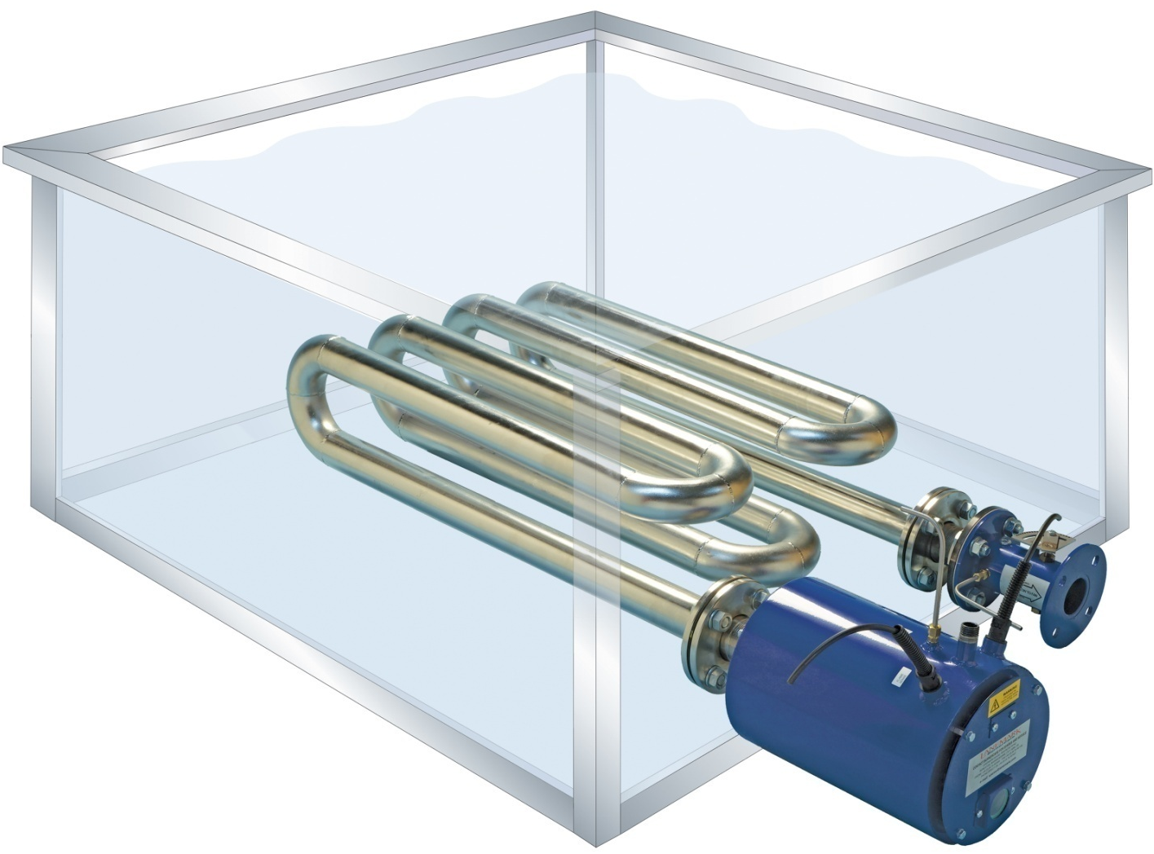
Lanemark Tank Heating Burner Washing Machine Systems & Applications

Slide 2
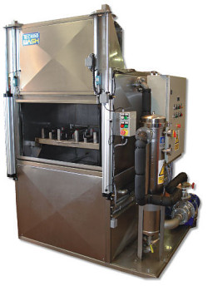

Lanemark Tank Heating Burner Systems
Cleaning (Industrial Washing Machines) – Industrial Parts Washers
An industrial parts washer is a piece of equipment used to remove contaminants or debris such as:
Dirt
Grime
Carbon
Oil
Grease
Metal Chips
Cutting fluids
Mould release agents
Ink
Paint
Corrosion
Industrial parts washers can be:
Manually operated
Fully automatic

Slide 3
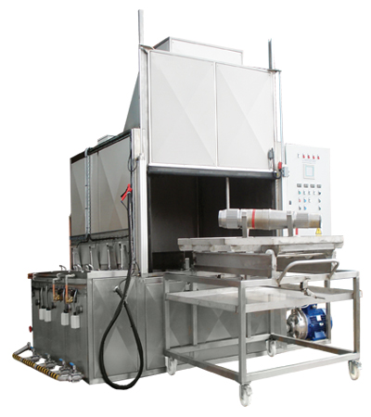
Lanemark Tank Heating Burner Systems
Cleaning (Industrial Washing Machines) – Industrial Parts Washers
Industrial parts washers are used in many different areas of industry to
Degrease components
Phosphate components
Wash components
Rinse components
Industrial washing machines will typically include multiple stages, e.g. degrease stage, wash stage and a rinse stage.
Typical areas of industry include:
Aerospace
Automotive
Remanufacturing
Heavy industry
Rail
General engineering
Printing

Slide 4

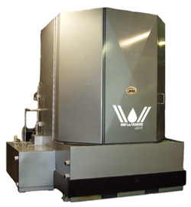
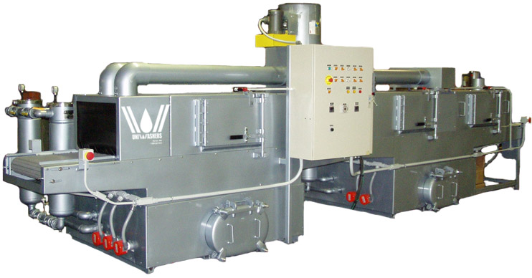
Lanemark Tank Heating Burner Systems
Cleaning (Industrial Washing Machines) – Industrial Parts Washers
There are many different types of industrial parts washers:
Front loading
Top loading
Rotary drum (www.youtube.com/user/vixenuk1#p/a/u/2/96QZowutfD8))
Rotary basket
Conveyor washers
The type of washer that is required will depend on the parts that are being cleaned and the overall process demands, i.e. batch/continuous cleaning, complexity of parts to be cleaned and available floor space.

Slide 5
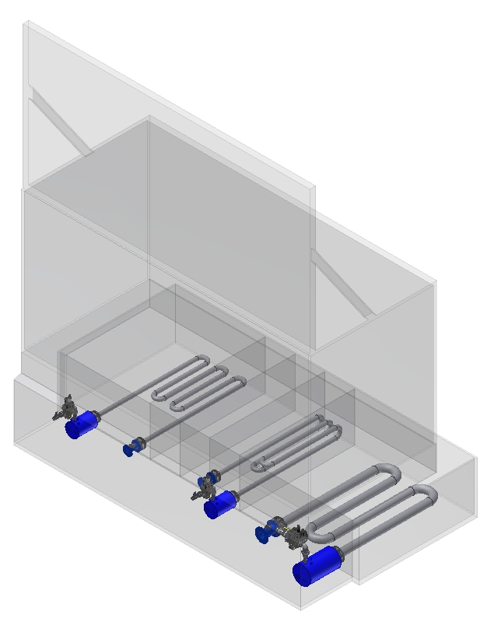
Lanemark Tank Heating Burner Systems
Industrial Parts Washing Installation: “Phoswash Machine”, Vixen Surface Technology, UK
The “Phoswash Machine” included the following tanks:
Phosphate Degrease
(TX20N at 60kW)
Cold Rinse
Wash
(TX20N at 60kW)
Hot Rinse
(TX40N at 300kW)
2 off TX20N each rated at 60kW max gas input
1 off TX40N rated at 300kW max gas input

Slide 6
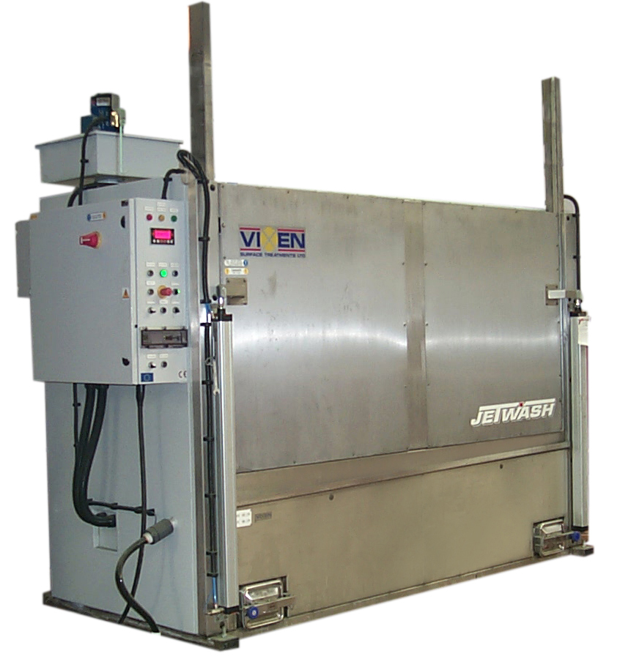
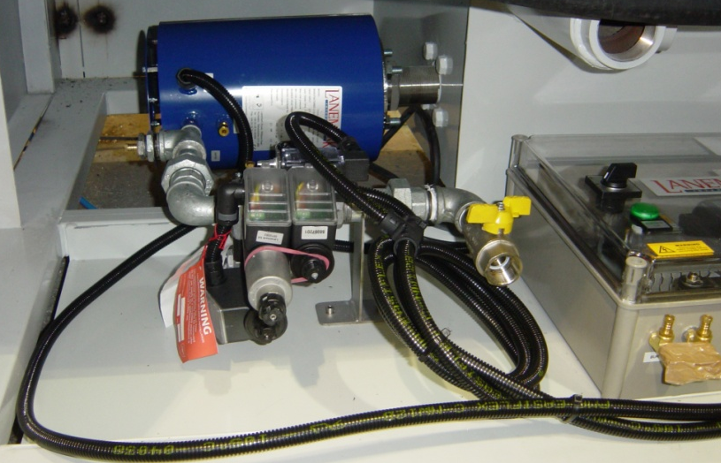
Lanemark Tank Heating Burner Systems
Industrial Parts Washing Installation: “Phoswash Machine”, Vixen Surface Technology, UK
TX20N rated at 60kW max gas input

Slide 7
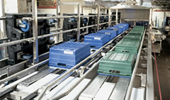
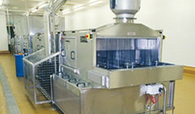
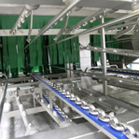
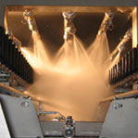
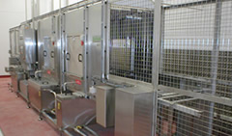
Lanemark Tank Heating Burner Systems
Cleaning (Industrial Washing Machines) – Plastic/Metal Tray/Crate Washers
Plastic/metal tray/crate washing machines are used in many different areas of industry, which typically include the following:
Food industry
Drinks industry
Distribution warehouses
Agricultural (plants/flowers) industry
The optimum cleaning of plastic/metal trays and crates utilised in food and drink production and distribution processes, relies on the performance of Lanemark tank heating burner systems – in use on machines supplied by many leading manufacturers of industrial plastic/metal trays and crate washers around the world.

Slide 8

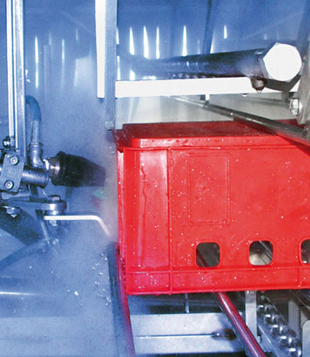
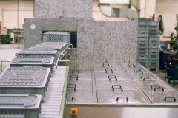
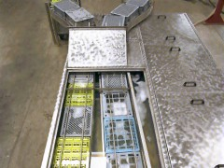
Lanemark Tank Heating Burner Systems
Cleaning (Industrial Washing Machines) – Plastic/Metal Tray/Crate Washers
The food industry relies heavily on plastic/metal trays/crates for food storage and distribution and these need to be washed after their use.
Food industries that use industrial washing machines include:
Bakeries
Fruit and vegetable producers
Fish stations
Food distribution warehouses
    (http://www.youtube.com/watch?v=CEeQh-u_r2M&feature=related)

Slide 9
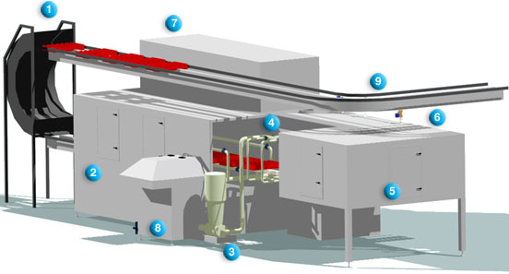
Lanemark Tank Heating Burner Systems
Cleaning (Industrial Washing Machines) – Plastic/Metal Tray/Crate Washers
Typical plastic/metal tray/crate washing machine
C-turner with waste hopper
Dissolving section
Heavy duty wash pump
Nozzle pipes in high pressure wash section
U-shaped wash tunnel
After-rinse section
Drying section
Filter screw with dirt separation
External chain conveyor

Slide 10
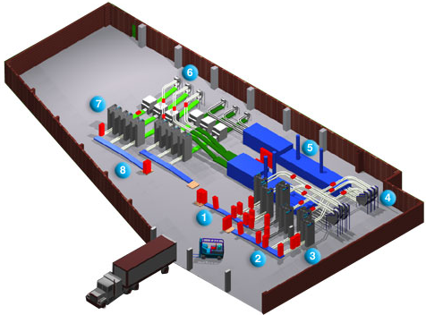
Lanemark Tank Heating Burner Systems
Cleaning (Industrial Washing Machines) – Plastic/Metal Tray/Crate Washers
Example of a distribution centre which includes plastic/metal tray/crate washing machines
Placing of tray/crate stacks for de-stacking
Conveyors to 6 de-stacking machines
Vertical de-stacking machines
Turning machines to empty waste
2 industrial washing machines
Turning machines prior to stacking
Vertical stacking machines
Delivery of washed tray/crate stacks

Slide 11
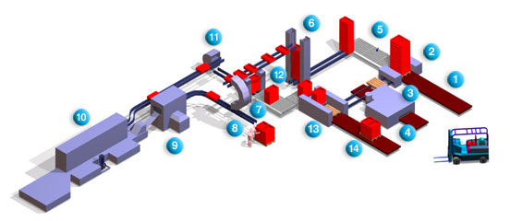
Lanemark Tank Heating Burner Systems
Cleaning (Industrial Washing Machines) – Plastic/Metal Tray/Crate Washers
Example of a food distribution centre which includes a plastic/metal tray/crate washing machine.
Feeding of pallets with soiled trays/crates
Depalletizing unit, sideway feeding of empty pallets to washer
Compact pallet washer
Discharge of empty pallets
Turning of tray/crate stacks
Vertical de-stacking unit
180° turning of trays/crates to empty waste
Manual stacking option
Pre-rinse unit; feeding to washing unit
Flume washing unit with pre-rinse, washing, and after-rinse
Tray/crate turner
Vertical stacking unit; feeding stacks to palletizer
Palletizing unit
Discharging of clean crates, stacked on pallets

Slide 12
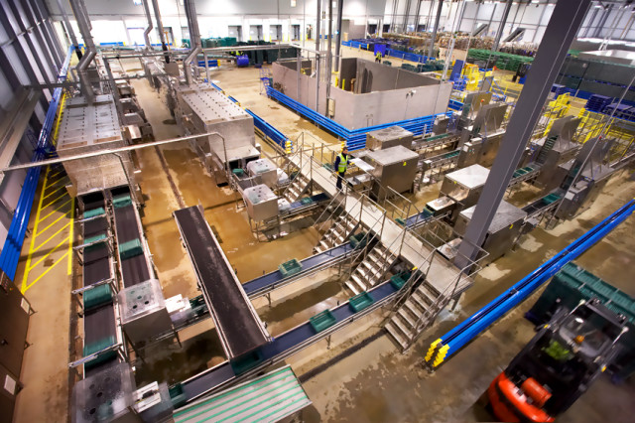
Lanemark Tank Heating Burner Systems
Cleaning (Industrial Washing Machines) – Plastic/Metal Tray/Crate Washers
Example of a distribution centre which includes plastic/metal tray/crate washing machines.

Slide 13
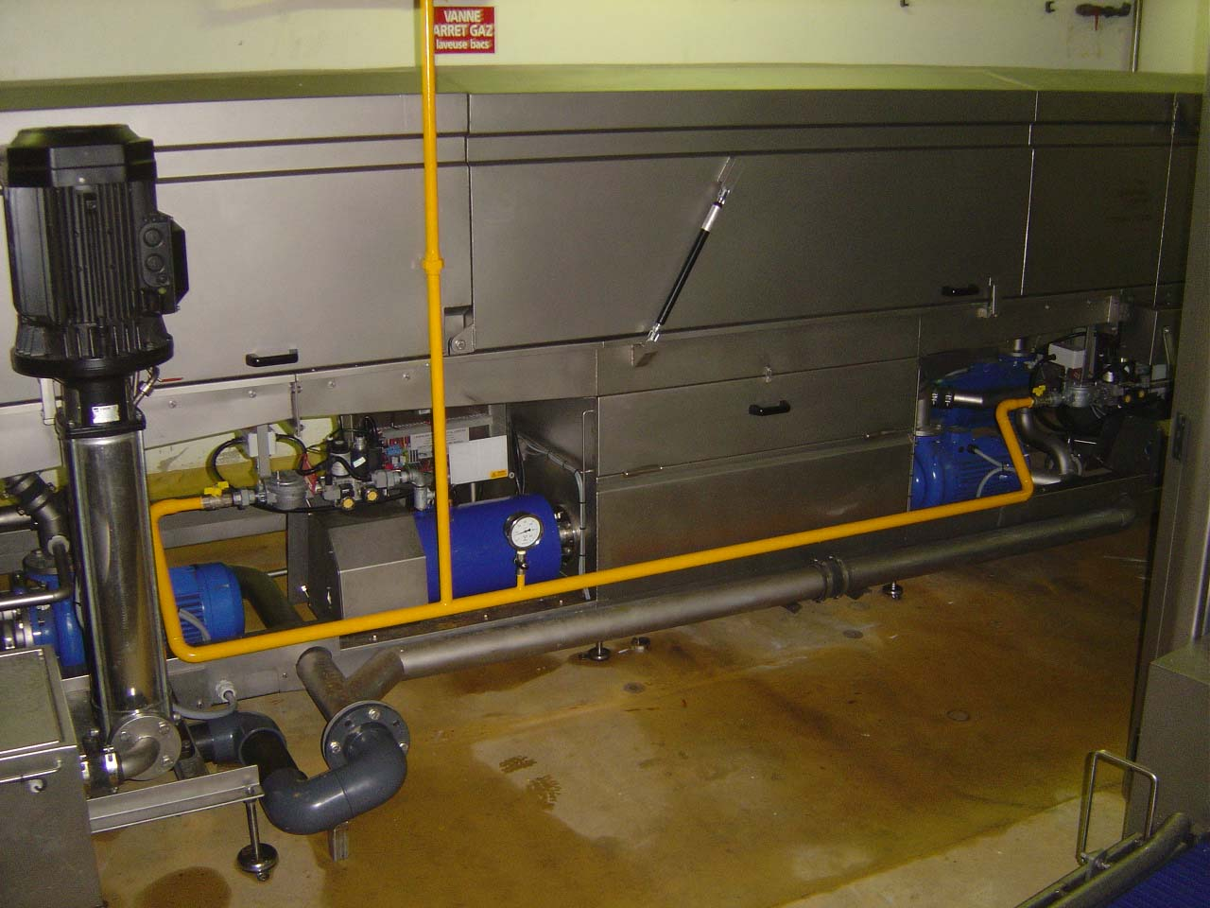
Lanemark Tank Heating Burner Systems
Tray/Crate Washing Installation: Numafa, Holland
2 off TX20N each rated at 80kW max gas input

Slide 14
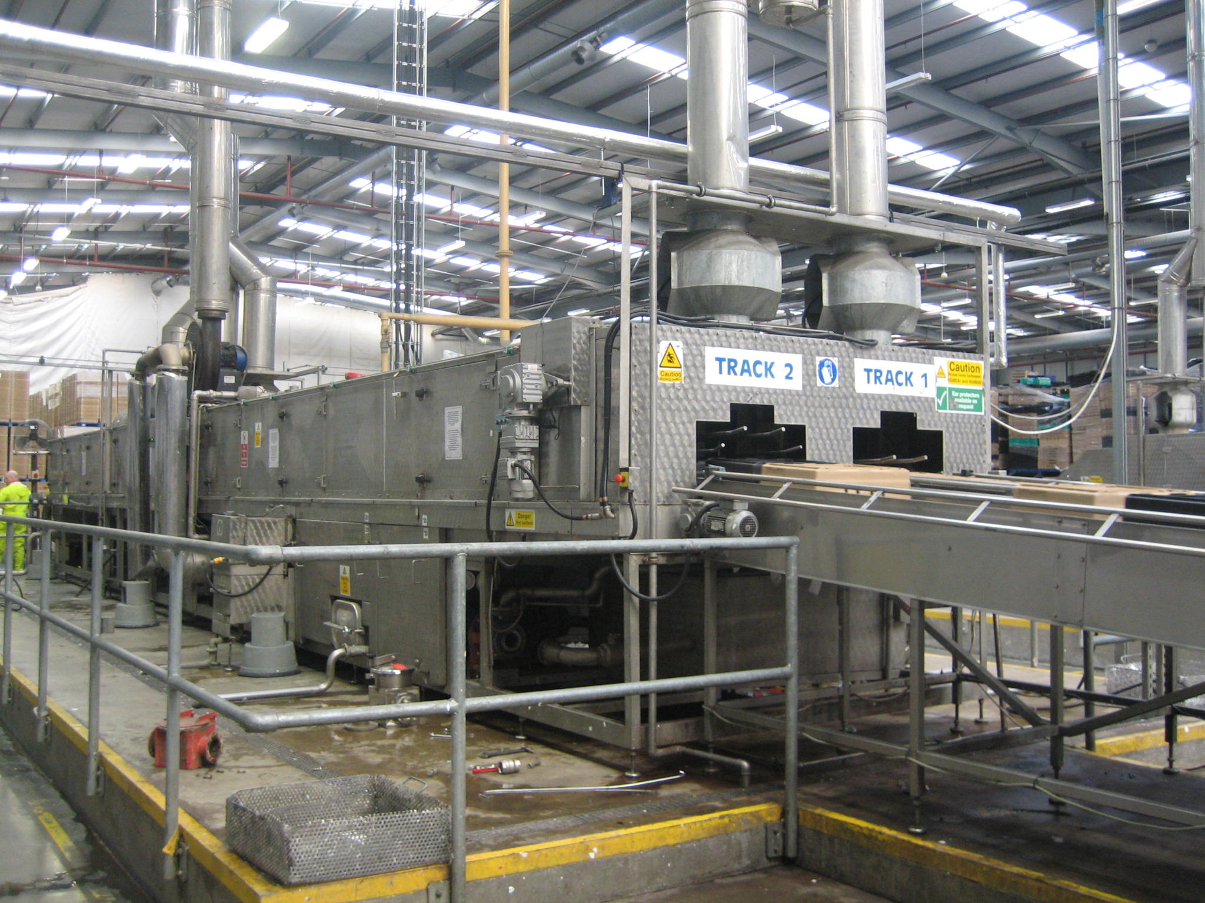
Lanemark Tank Heating Burner Systems
Tray/Crate Washing Installation: Norbert Dentressangle, UK
2 off TX40N each rated at 286kW max gas input
1 off TX60N rated at 689kW max gross input

Slide 15
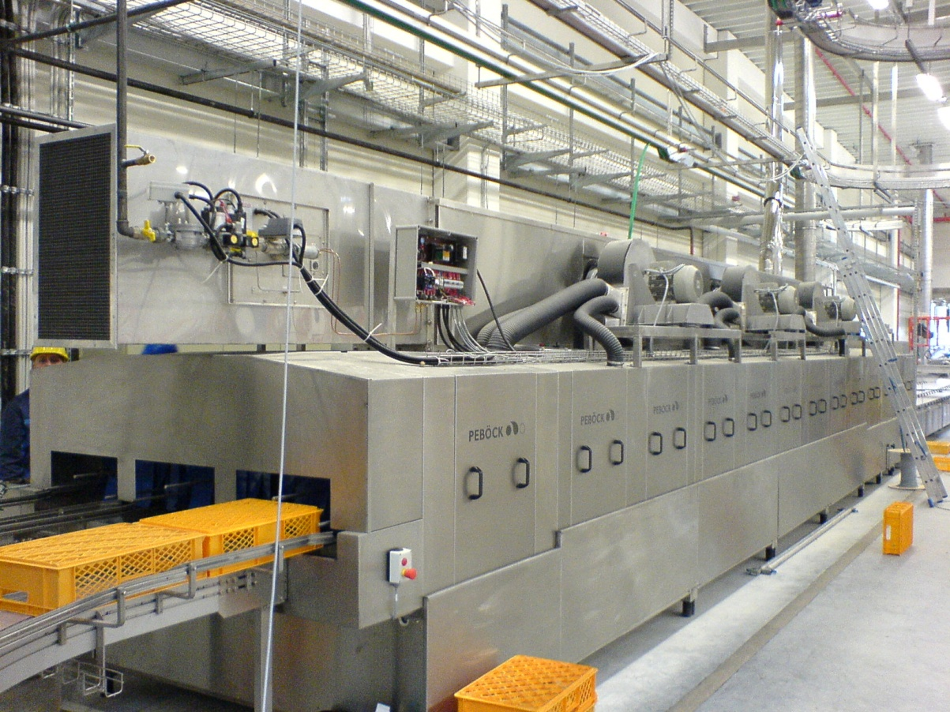
Lanemark Tank Heating Burner Systems
Tray/Crate Washing Installation: MTV Pebock, Germany
1 off TX30N each rated at 145kW max gas input
1 off TX30N each rated at 121kW max gas input
1 off TX20N each rated at 60kW max gas input

Slide 16
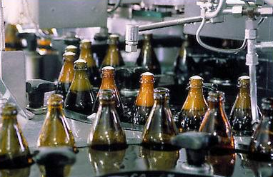
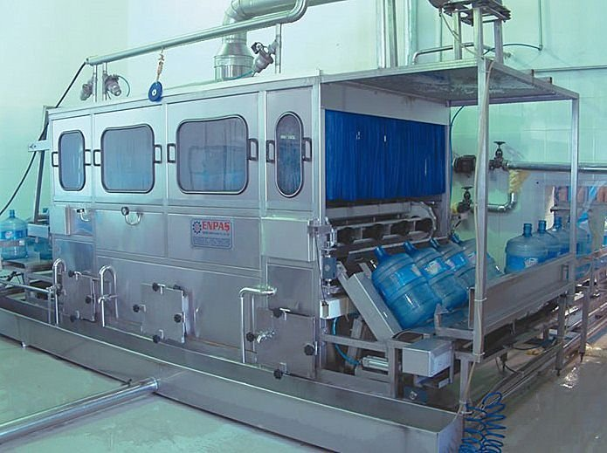
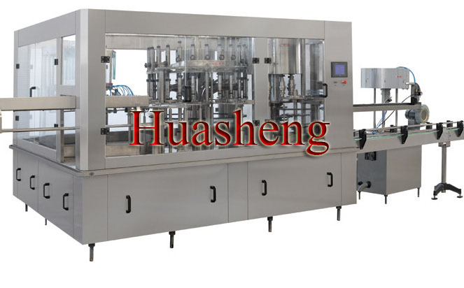
Lanemark Tank Heating Burner Systems
Cleaning (Industrial Washing Machines) – Industrial Bottle Washers
Bottle washing machines are used primarily in the food and drinks industry and are suitable for the following types of bottles:
Plastic (PET) bottles
Glass bottles
The machines are generally designed to clean various types of glass bottles or plastic bottles either round or odd shaped, subjecting it to a series of distinct processing operations. The washing is by means of powerful stationary water jets in three different sections with varying duration. The output attained from this equipment can range to meet the process demands.

Slide 17
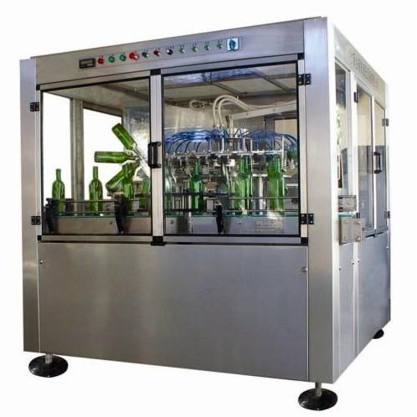


Lanemark Tank Heating Burner Systems
Cleaning (Industrial Washing Machines) – Industrial Bottle Washers
A bottle washing machines is designed to wash and sanitize the bottles in compliance with the food and drinks regulations as required and will typically include the following:
1. Unit where the residual liquid in the bottles is disposed of
2. Pre washing
3. Hot washing with appropriate chemicals
4. Pre rinsing washing
5. Washing with disinfectants
6. Final rinsing
http://www.youtube.com/watch?v=a1f01aF2h8w&feature=related

Slide 18
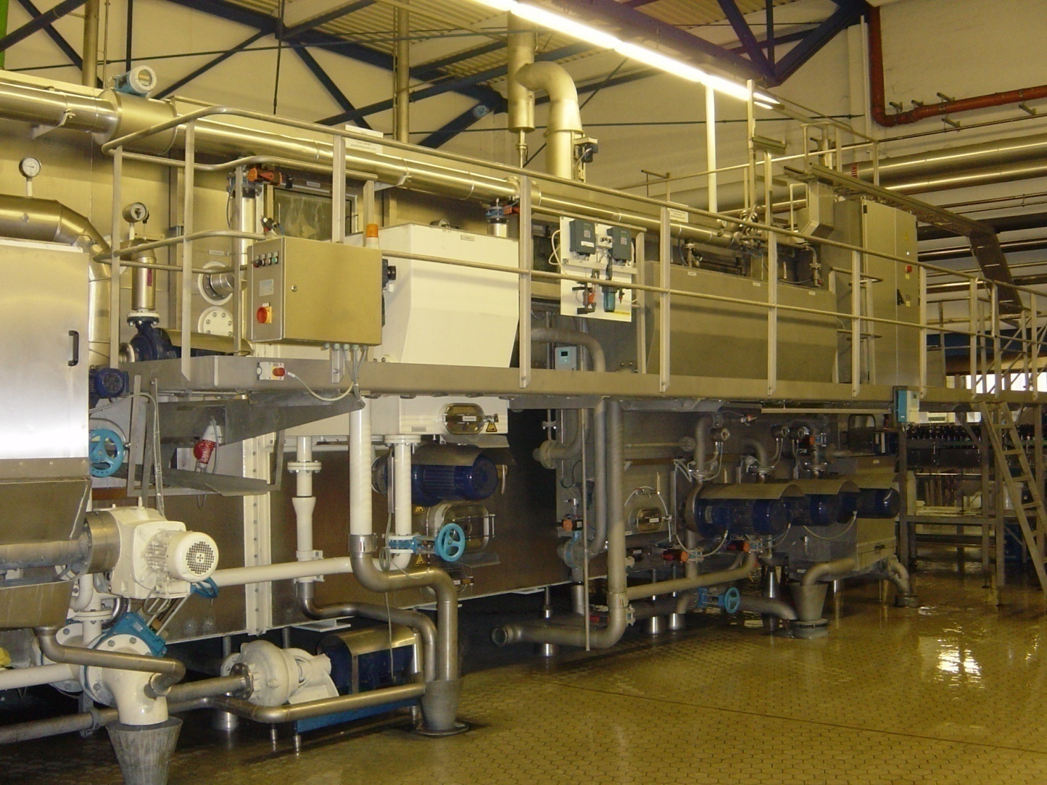
Lanemark Tank Heating Burner Systems
Bottle Washing Installation: Kulmbacher Brewery, Germany
2 off TX60N each rated at 460kW max gas input

Slide 19
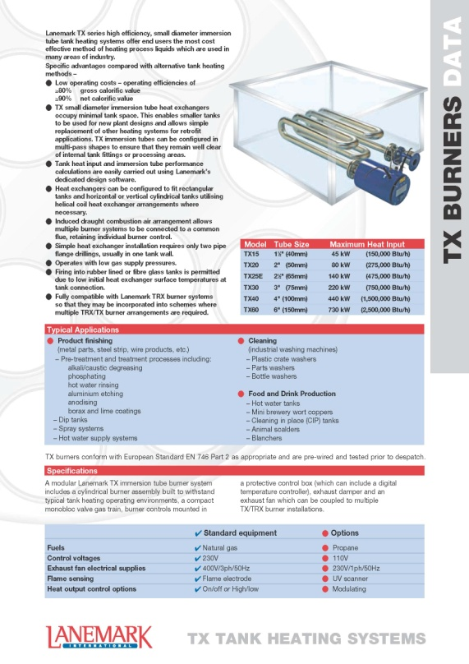
Lanemark Tank Heating Burner Systems
TX series burner systems:
Operation : High/Low or On/Off
The TX system includes a burner assembly, compact monoblock valve train, burner controls, exhaust damper and an exhaust fan.
Model | Tube Size | Maximum Heat Input
TX15 | 1½” (40mm) | 45kW (150,000 Btu/h)
TX20 | 2” (50mm) | 80kW (275,000 Btu/h)
TX25E | 2½” (65mm) | 140kW (475,000 Btu/h)
TX30 | 3” (75mm) | 220kW (750,000 Btu/h)
TX40 | 4” (100mm) | 440kW (1,500,000 Btu/h)
TX60 | 6” (150mm) | 730kW (2,500,000 Btu/h)

Slide 20
Lanemark Tank Heating Burner Systems
The operation of the TX series burner system is On/Off or High/Low. The TX burner system can also be specified as either Modulating Gas only or Modulating Gas + Air.
 | Standard Equipment | Options
Fuels | Natural gas | Propane gas
Control Voltages | 230V | 110V
Exhaust Fan Electrical Supplies | 400V/3ph/50Hz* (*60Hz option also available) | 230V/1ph/50Hz*
Flame Sensing | Flame Electrode | U.V. Cell
Heat Output Control Options | On/Off or High/Low | Modulating (gas only) 0-10V DC or 4-20mA or 3 wire valve positioning or Modulating (gas + air) 0-10V DC or 4-20mA

Slide 21
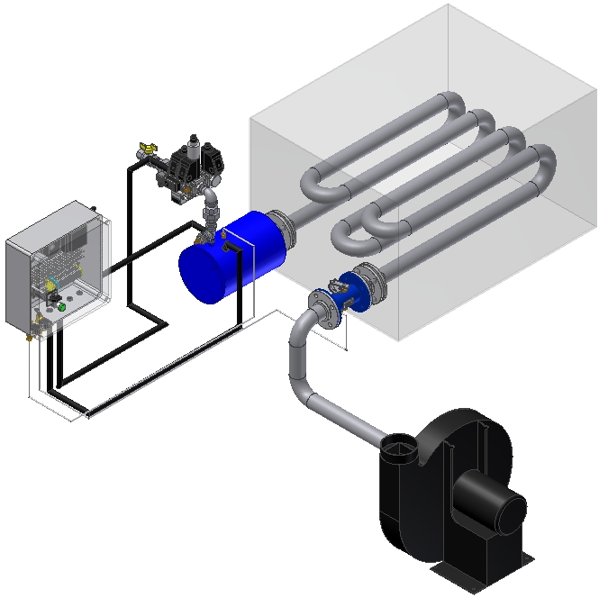
Lanemark Tank Heating Burner Systems
A typical Lanemark TX series high efficiency, small diameter immersion tube tank heating systems comprises:
Burner assembly
Gas valve train assembly
Control box
Flanged exhaust damper
Exhaust fan
2
1
3
4
5

